Slide 1


Slide 2
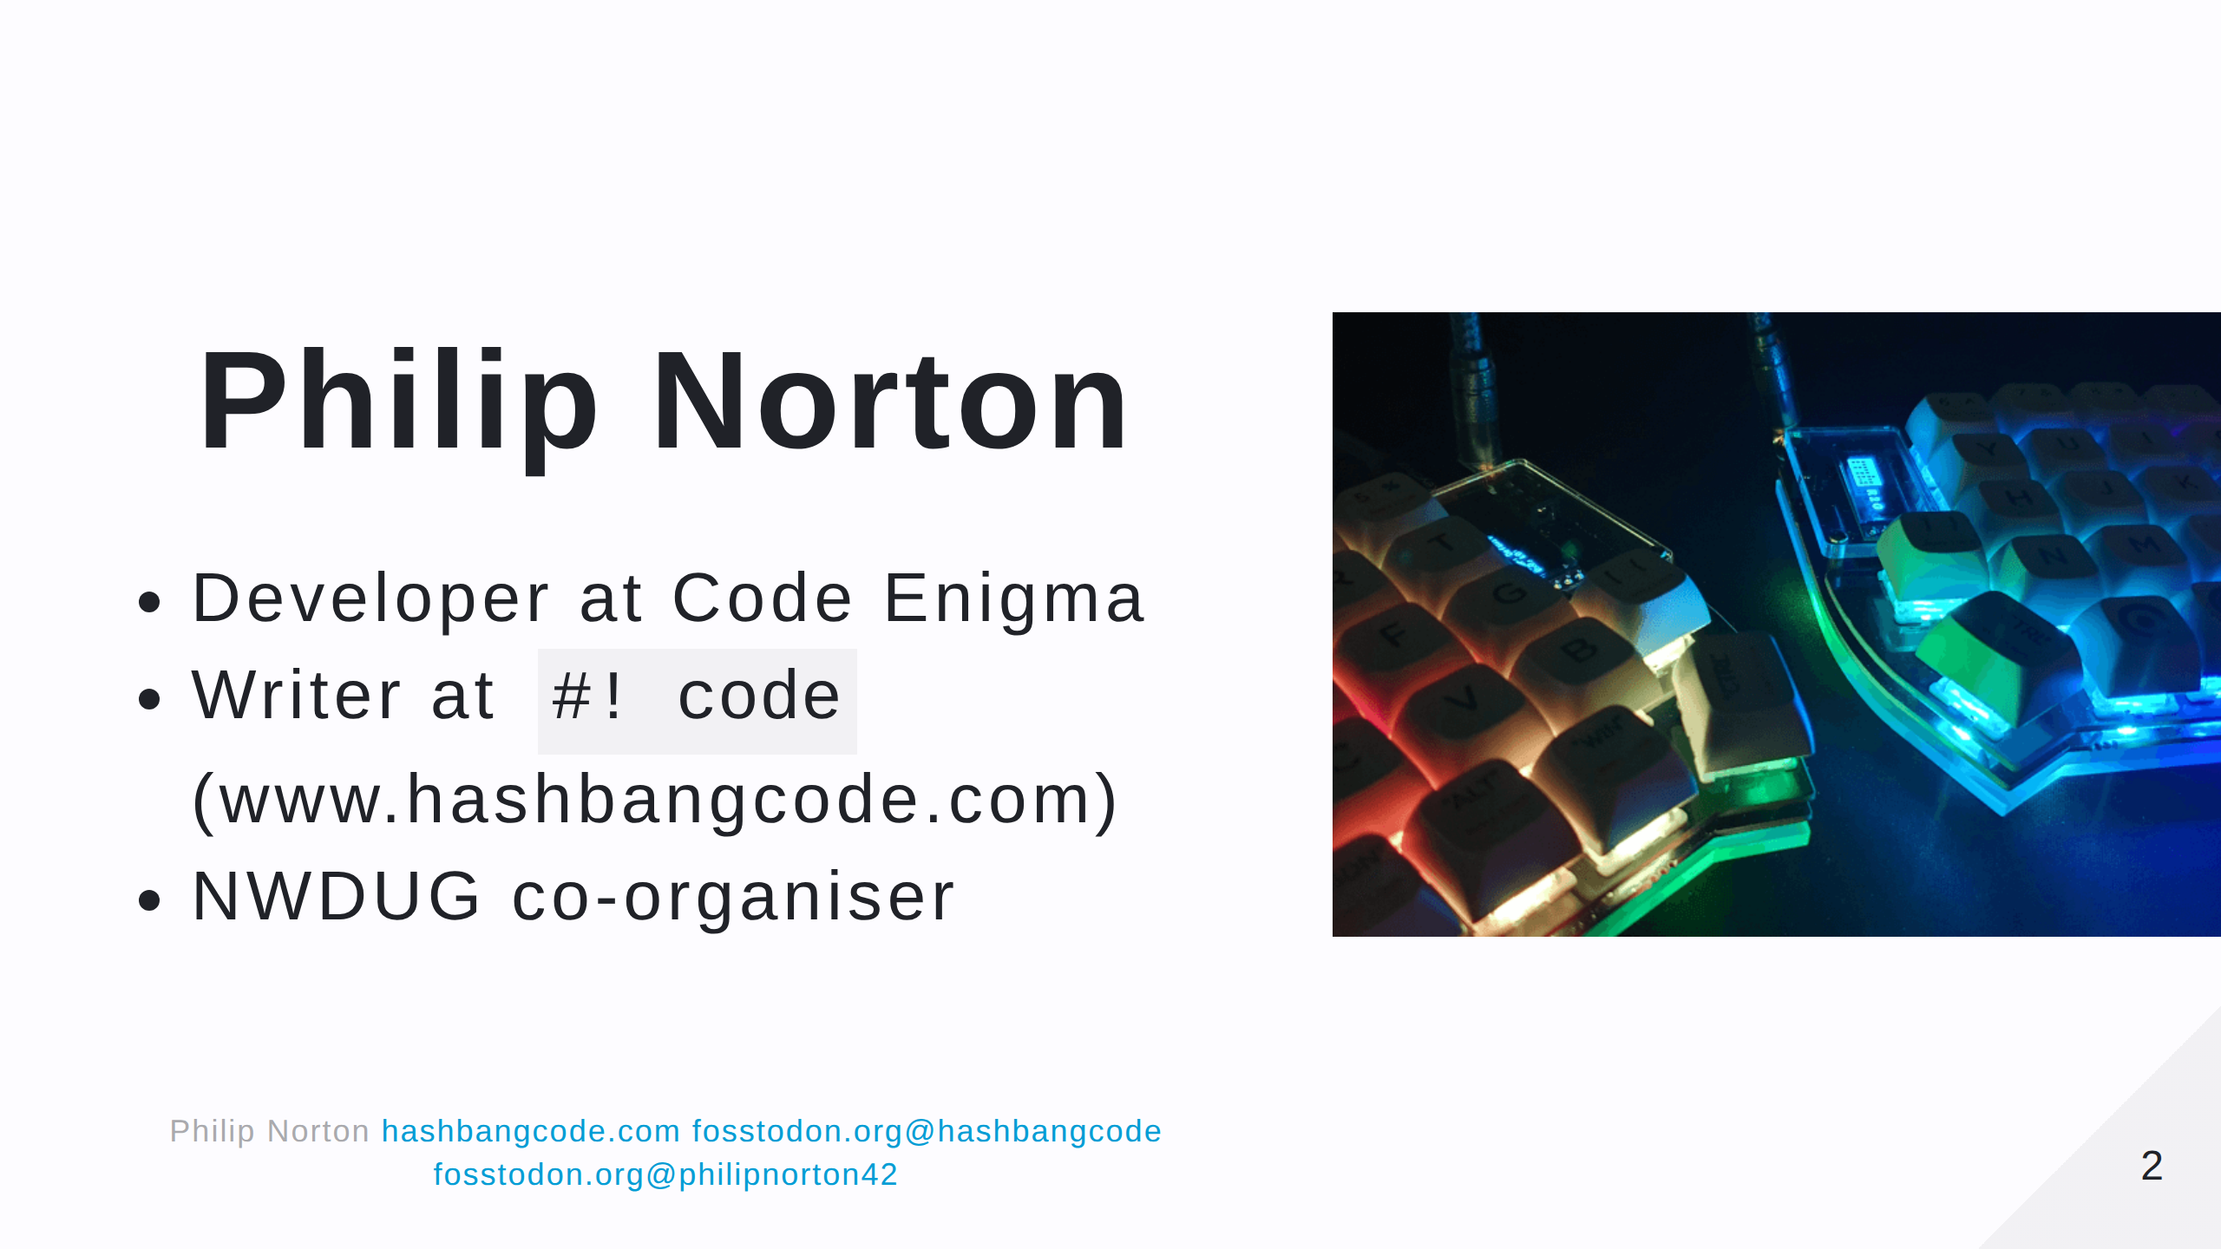
Notes:
- Doing Drupal for about 15 years. - Programming in general for about 20 now. - This is a picture of a Lily58 mechanical keyboard.

Slide 3
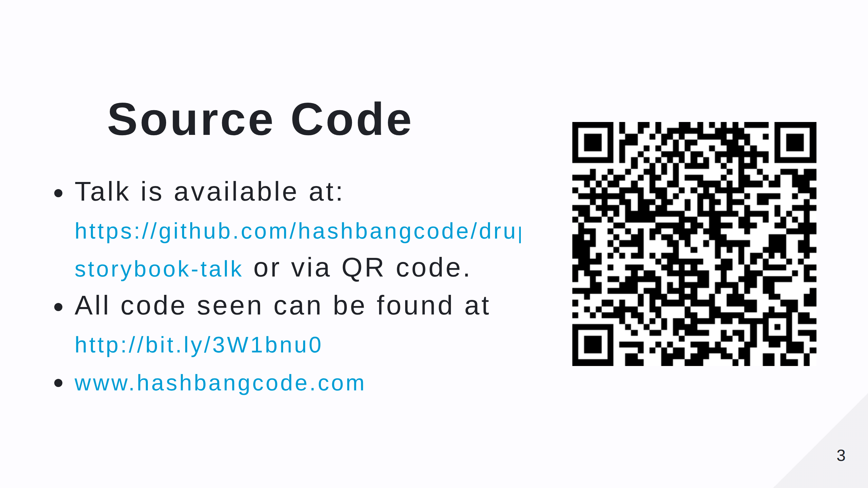
Notes:
- Scan the QR code for the talk repo. Which has links to all of the resources you need. - There's also a Drupal and Storybook article on my site.

Slide 4
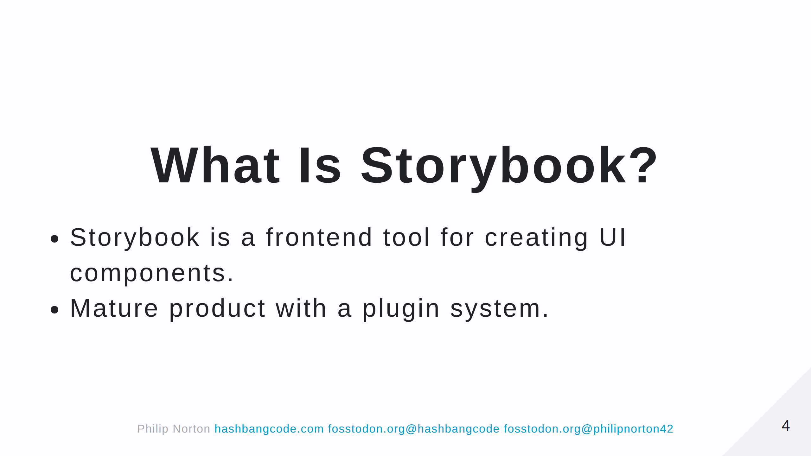

Slide 5
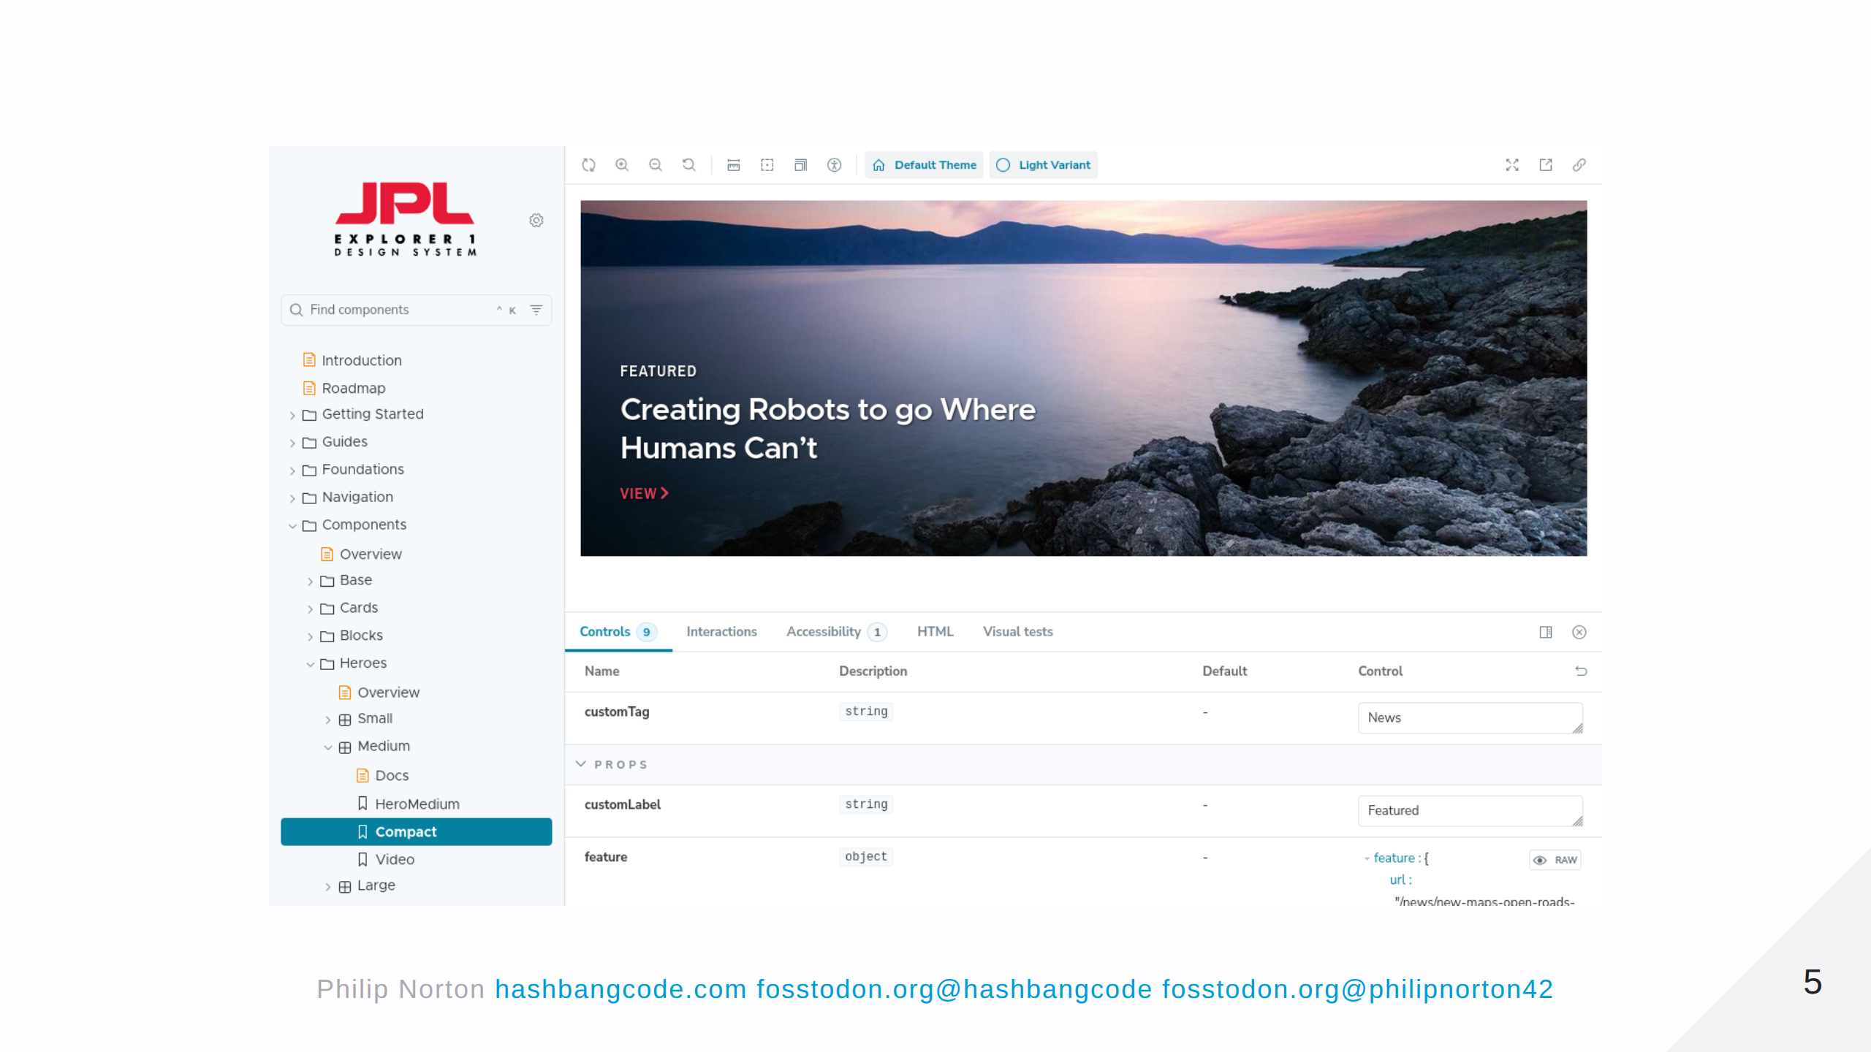
Notes:
I've been looking at Storybook for a few years, but there's always been a disconnect between Storybook and Drupal. I could build the stories in Storybook, but I'd then have to rebuild them in Drupal. Here is an example of Storybook used by the JPL.

Slide 6
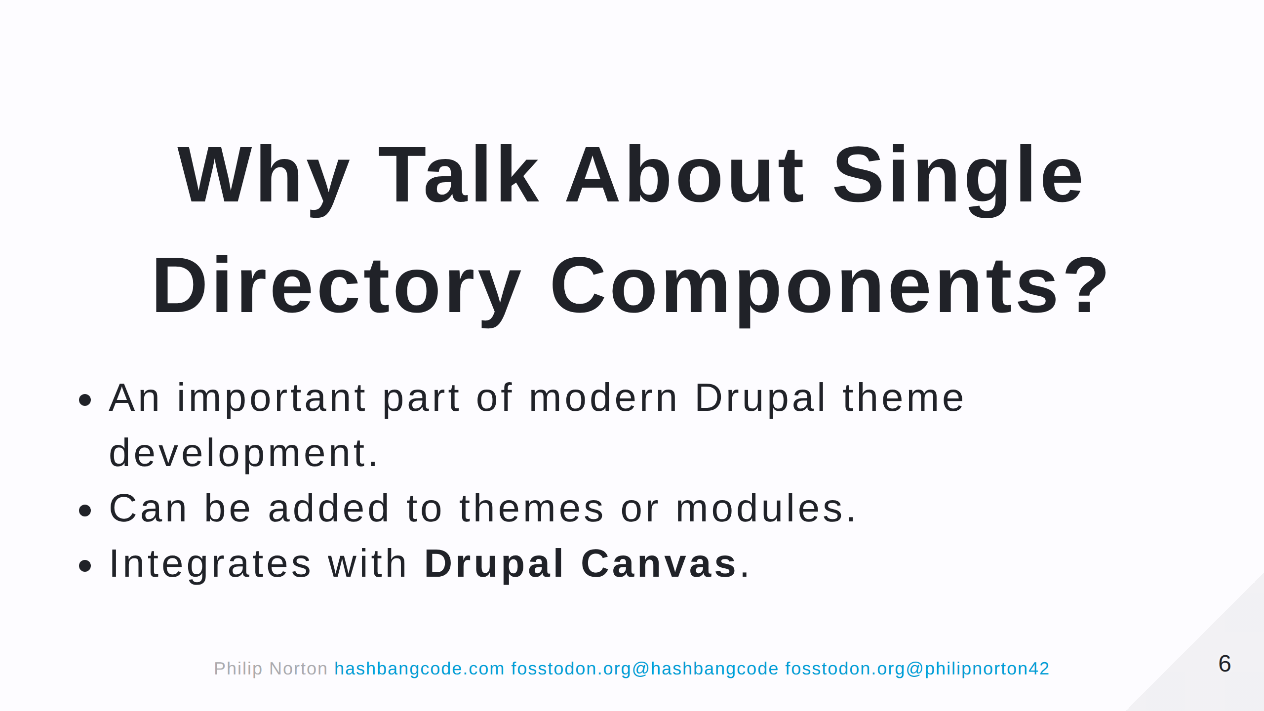
Notes:
Now is a good time to get into SDC.

Slide 7
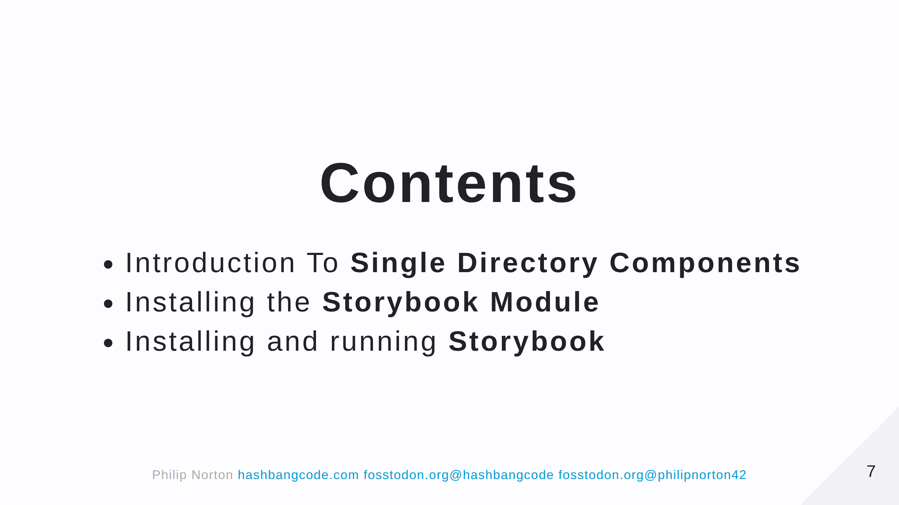
Notes:
That changed with SDC and is facilitied by the Storybook module.

Slide 8
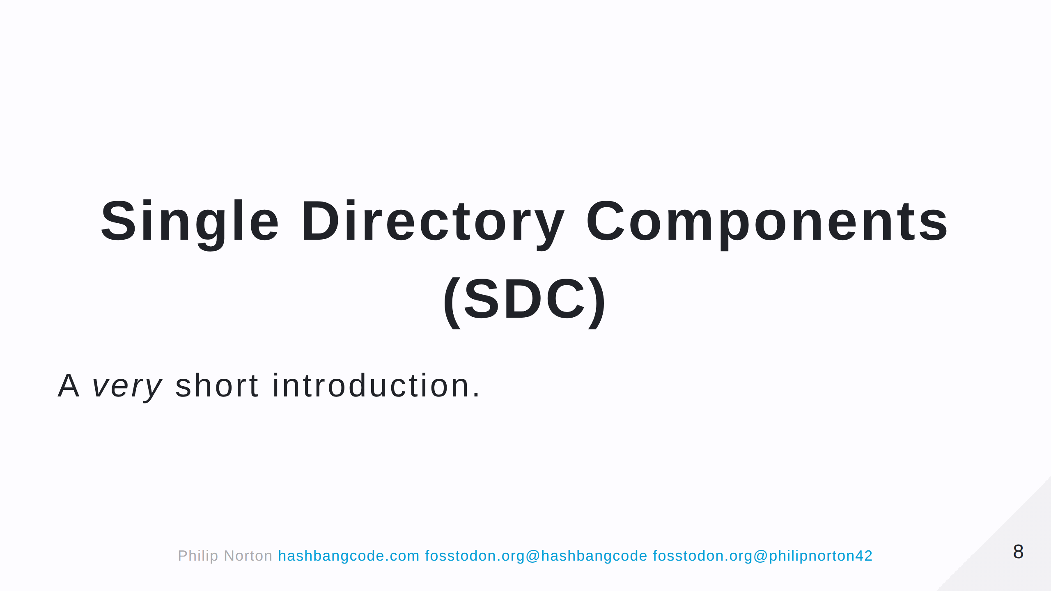
Notes:
From this point on SDC will be Single Directory Components.

Slide 9
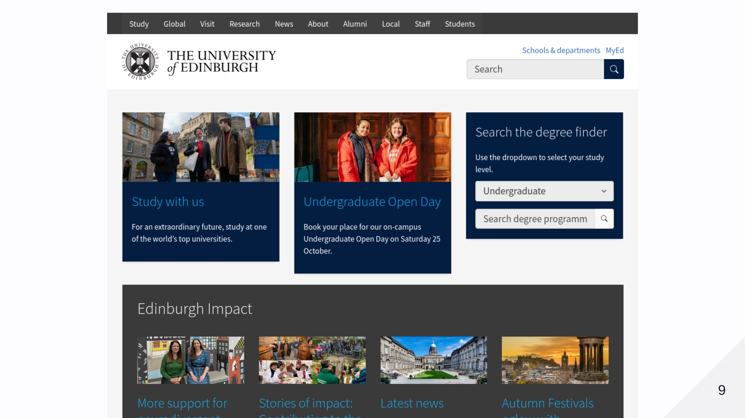

Slide 10
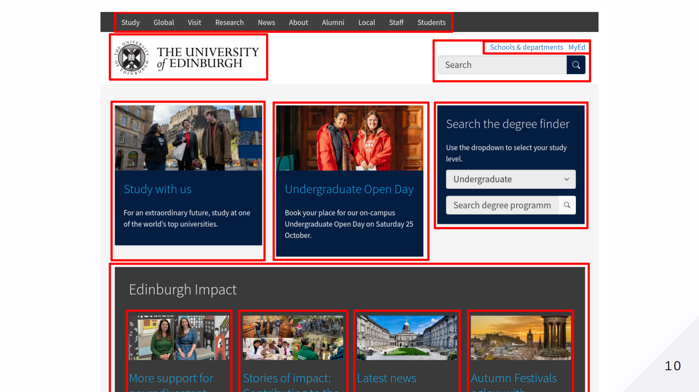

Slide 11
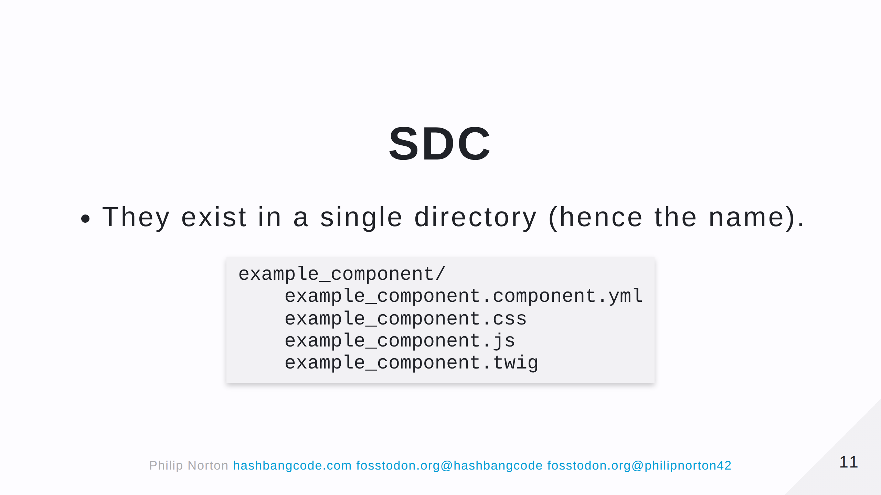
Notes:
This directory can exist in a theme or module. Let's look at each of the files.

Slide 12
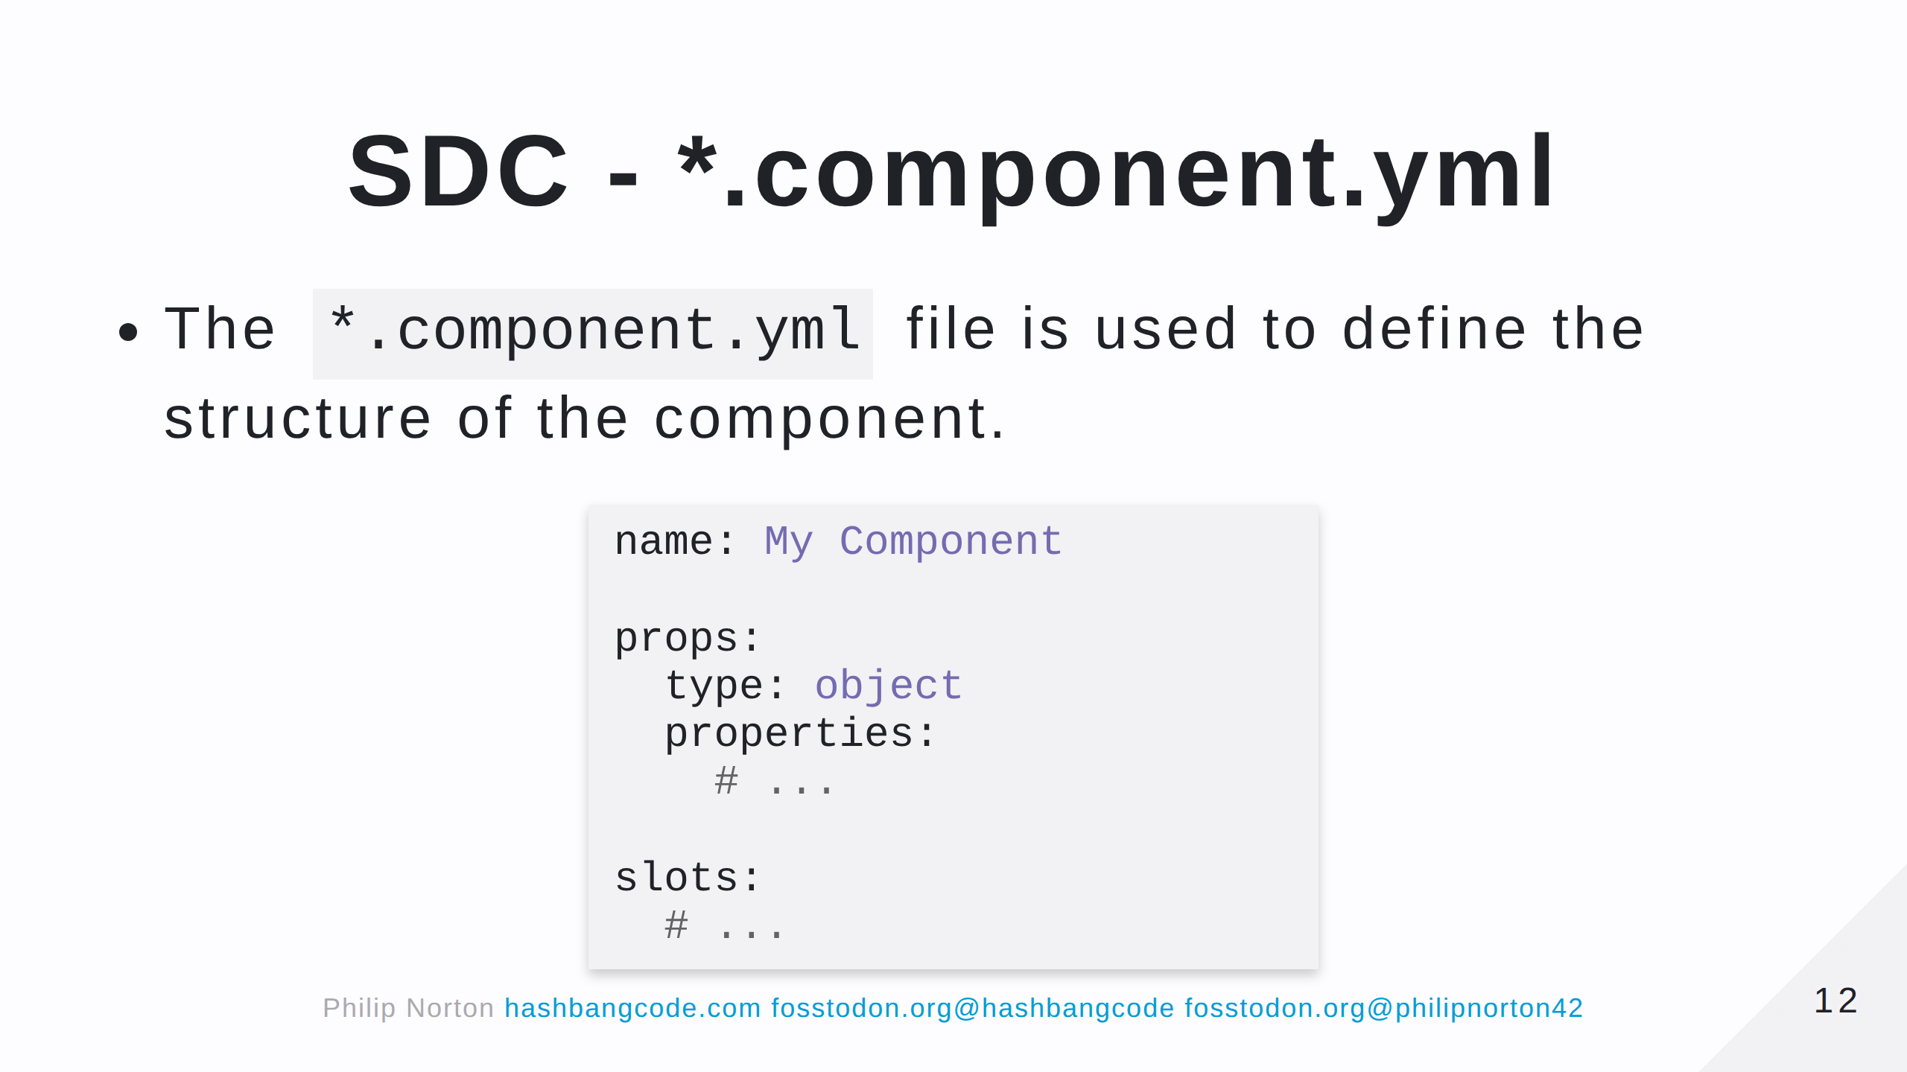
Notes:
Note that when you create a component in a module this file is heavily validated. In the theme, you can 'get away' with a bit more.

Slide 13
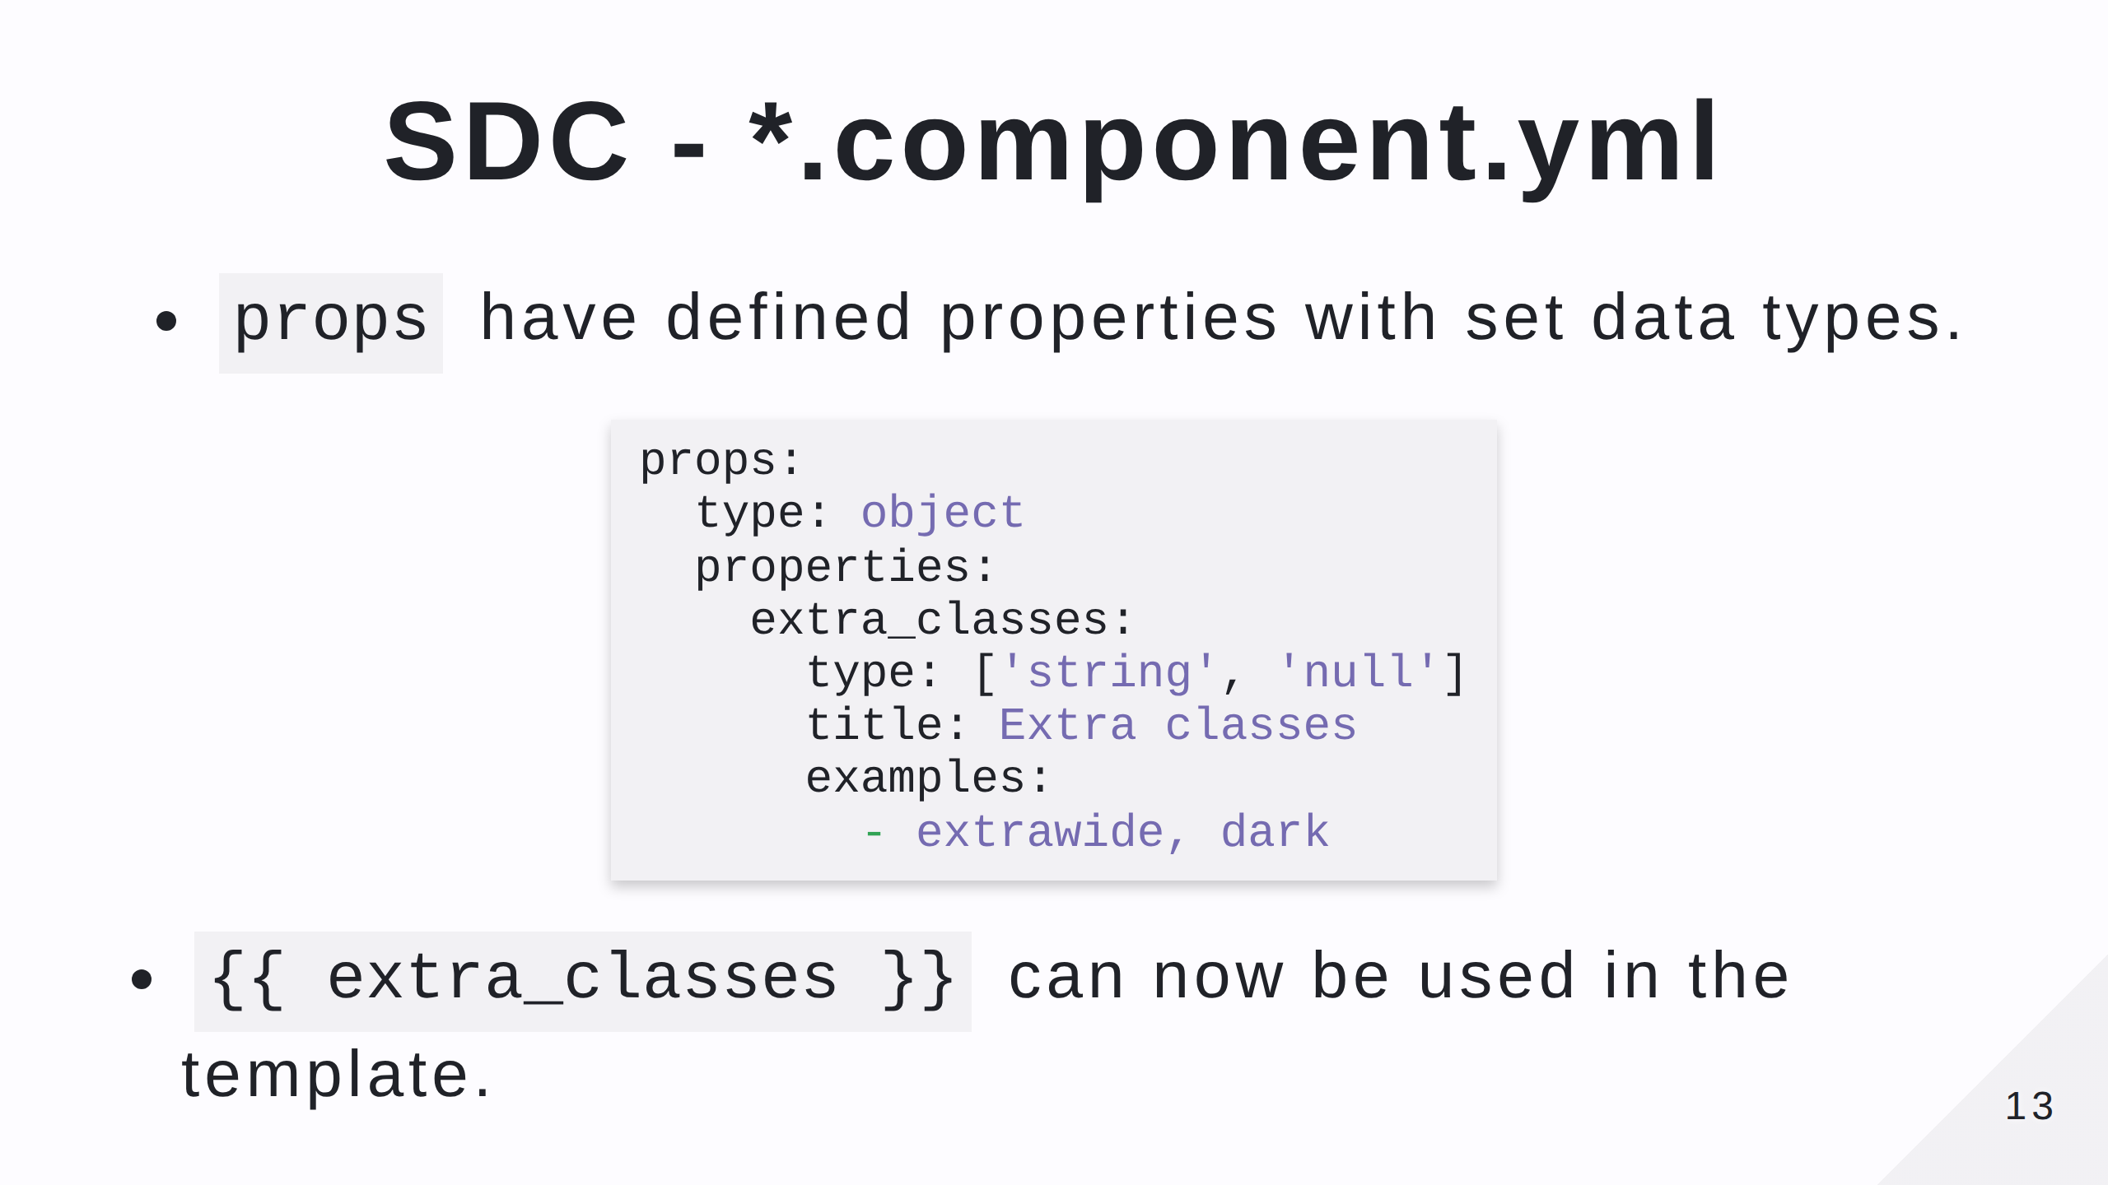

Slide 14
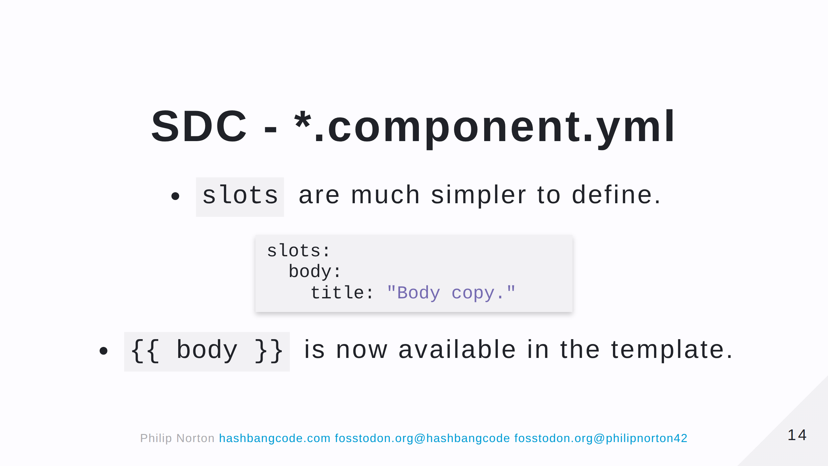

Slide 15
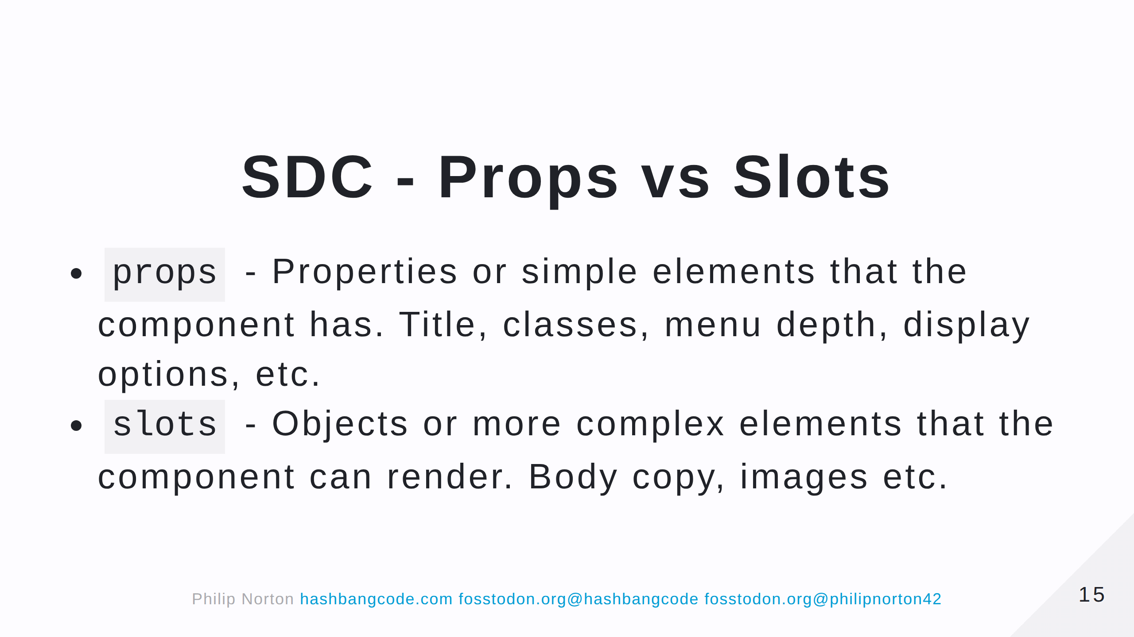

Slide 16
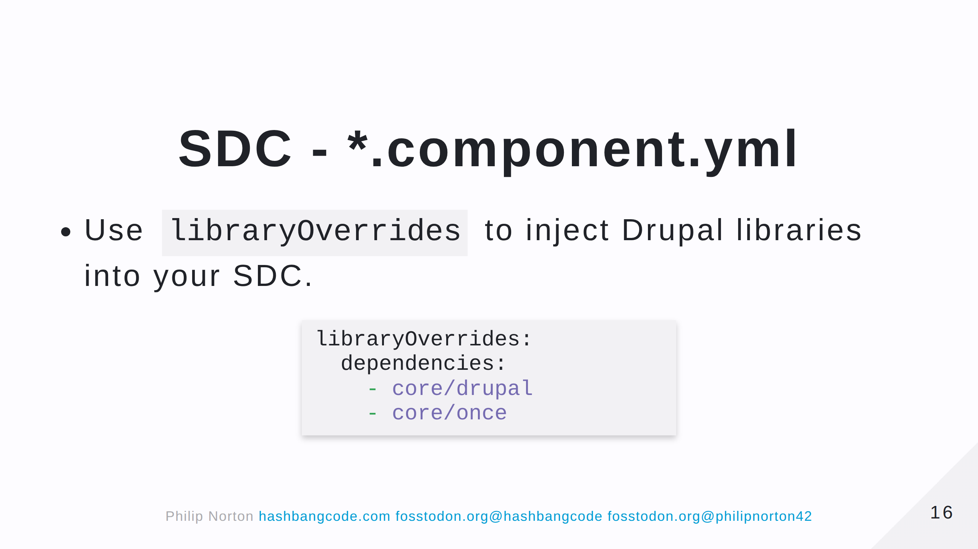

Slide 17
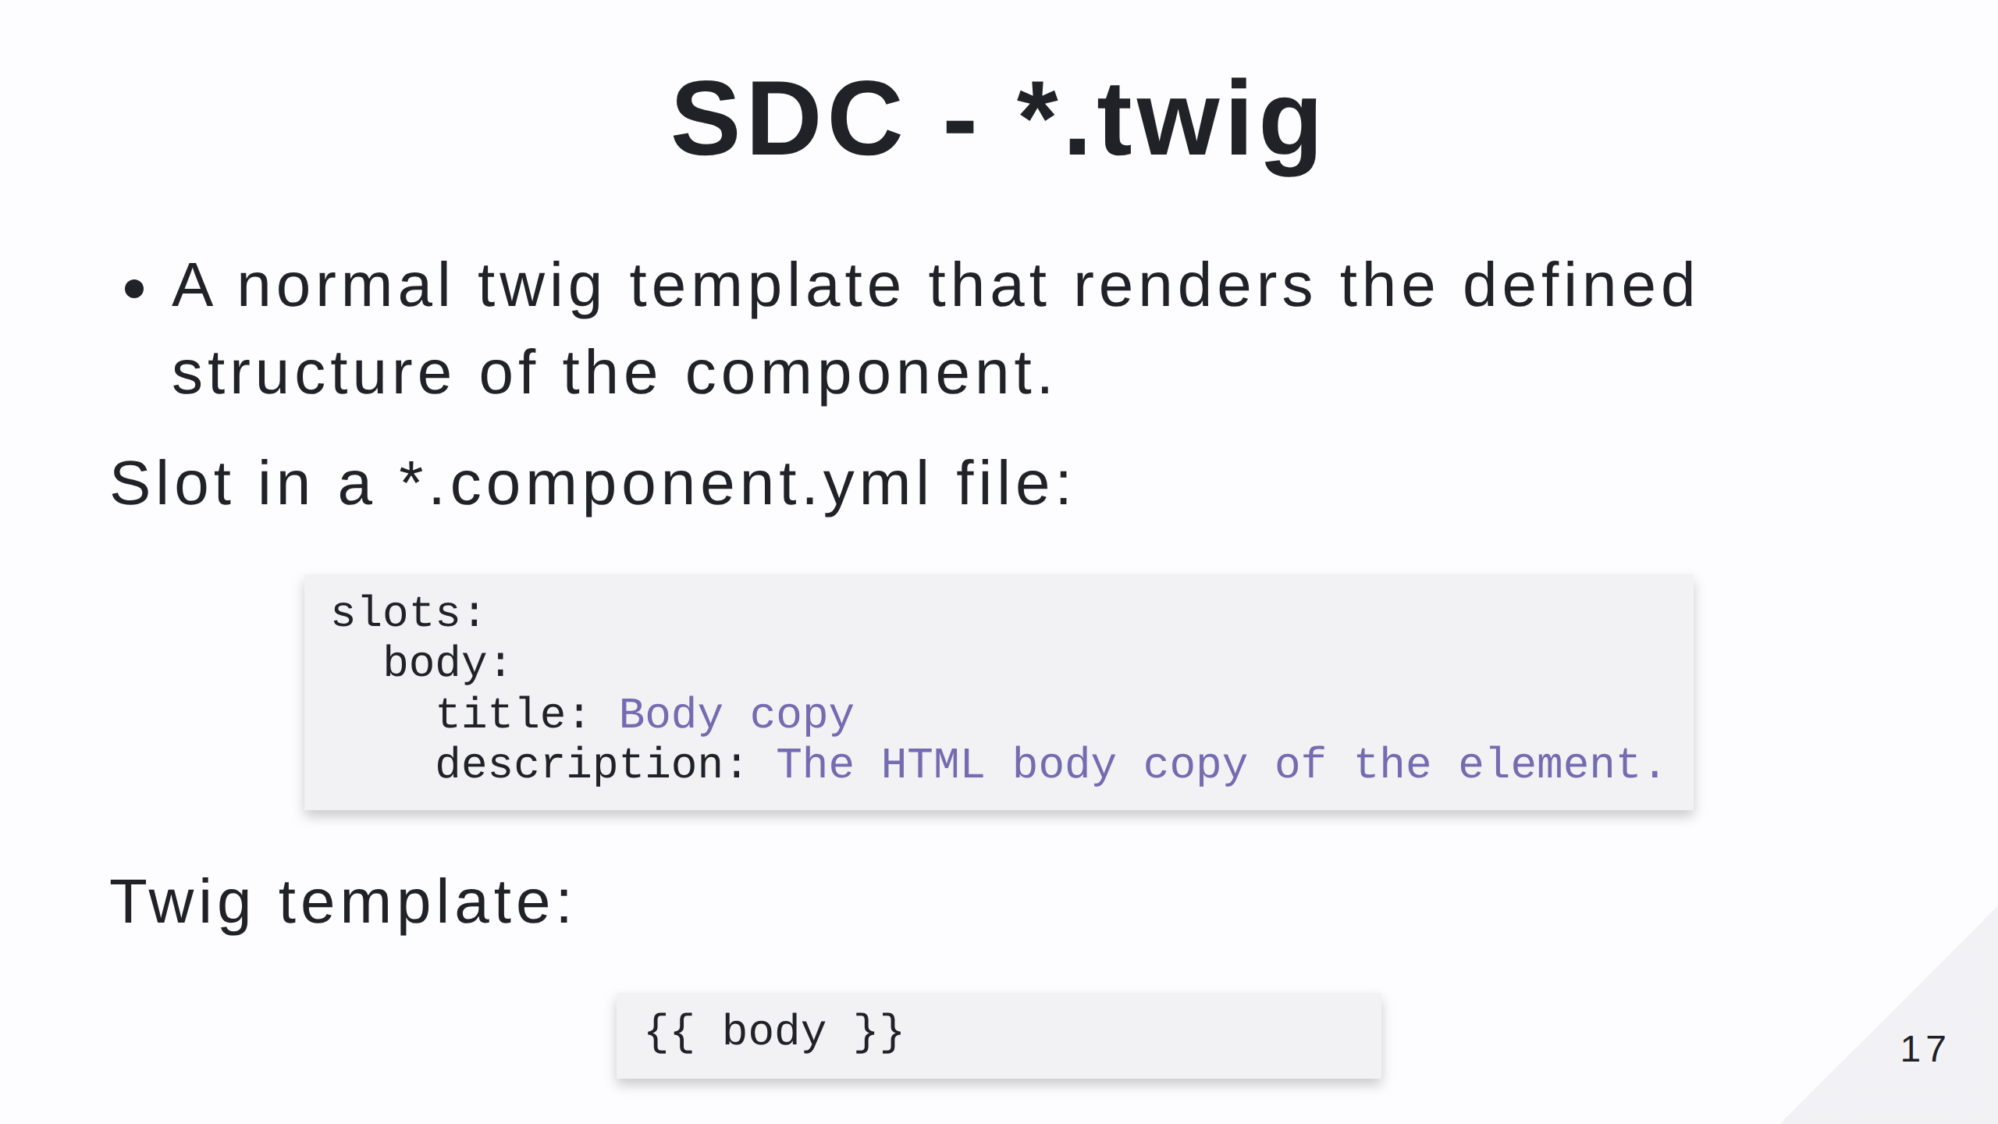

Slide 18
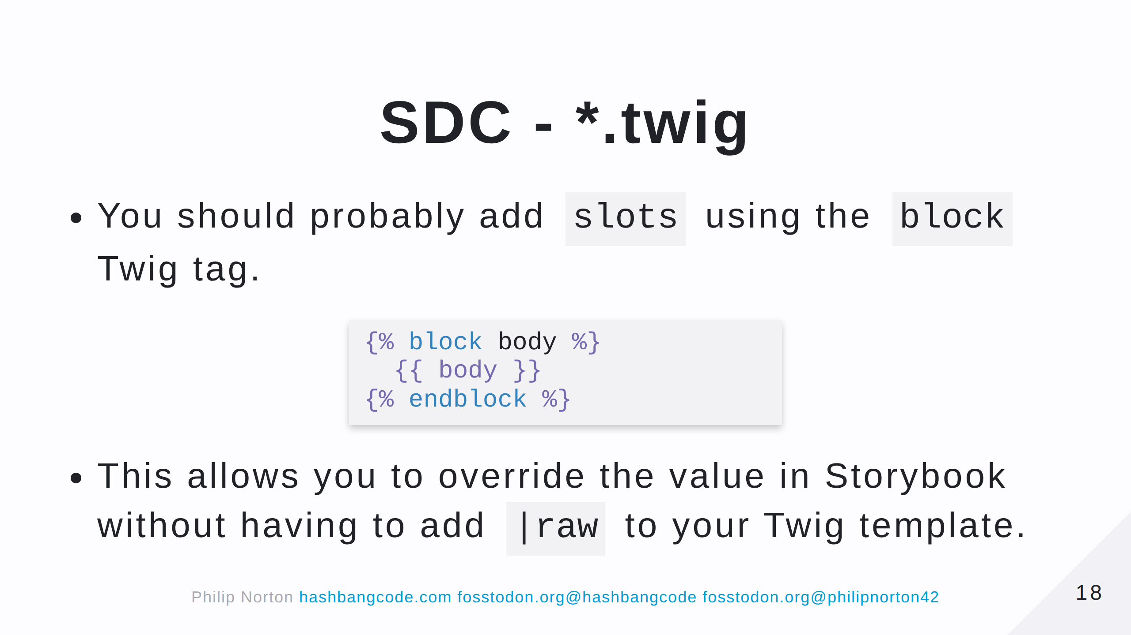

Slide 19
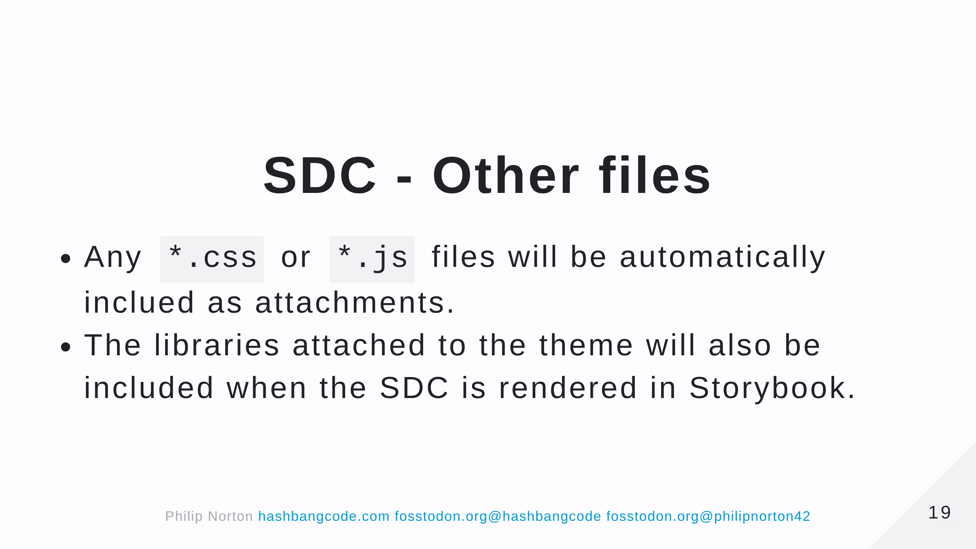

Slide 20
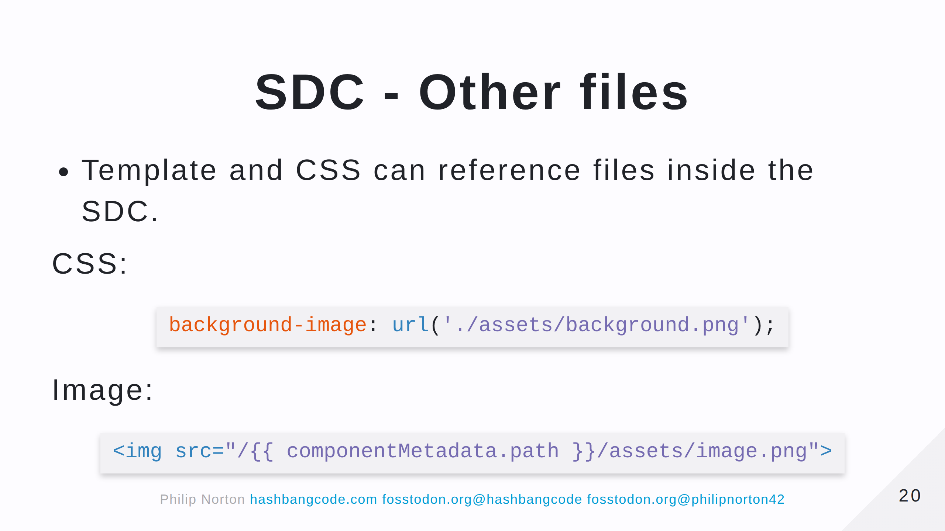
Notes:
The componentMetadata object contains some information about the component. In this case we are using the .path property that contains the current path of the SDC.

Slide 21
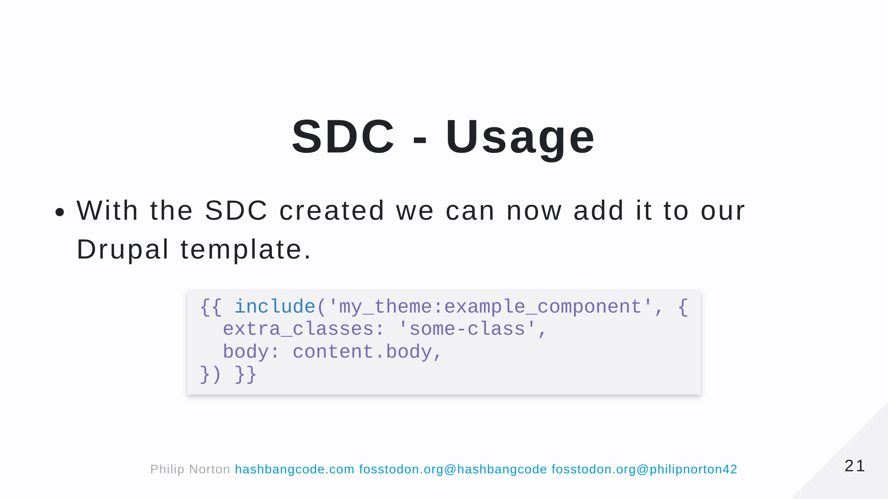

Slide 22
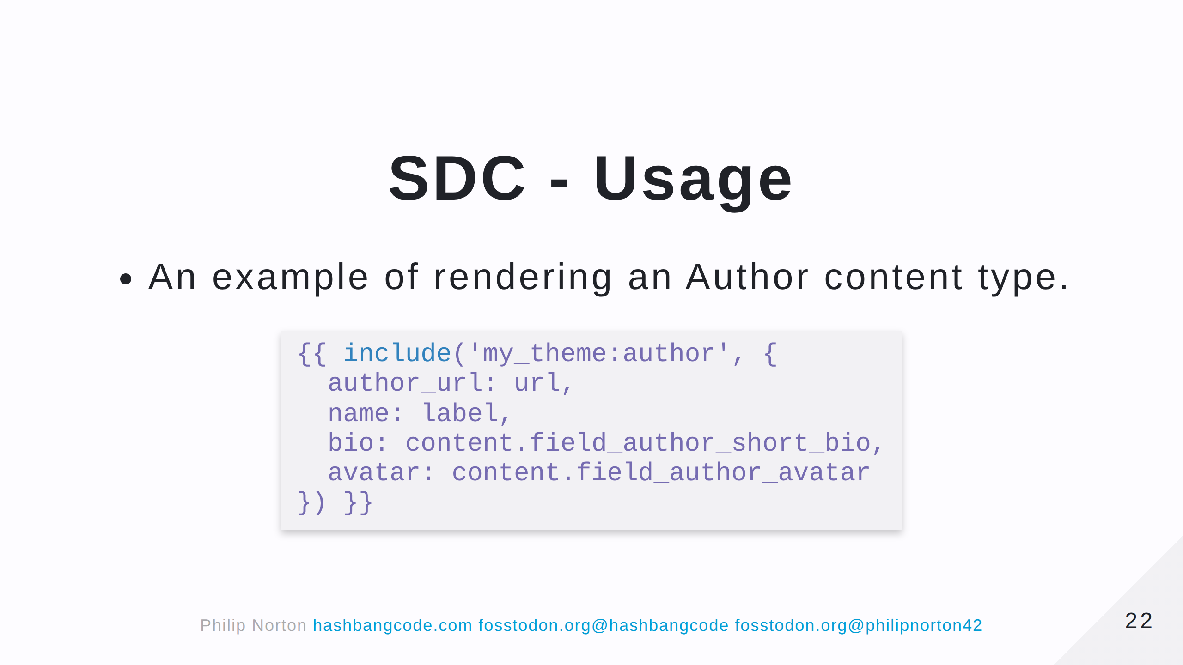

Slide 23
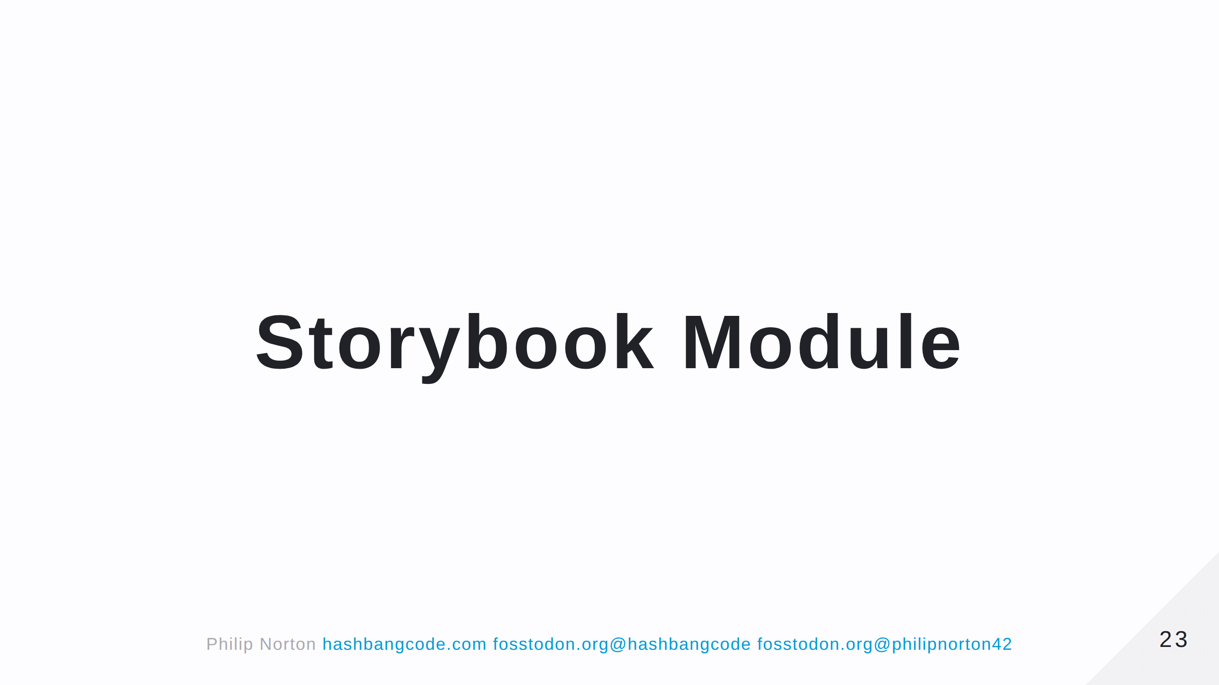

Slide 24
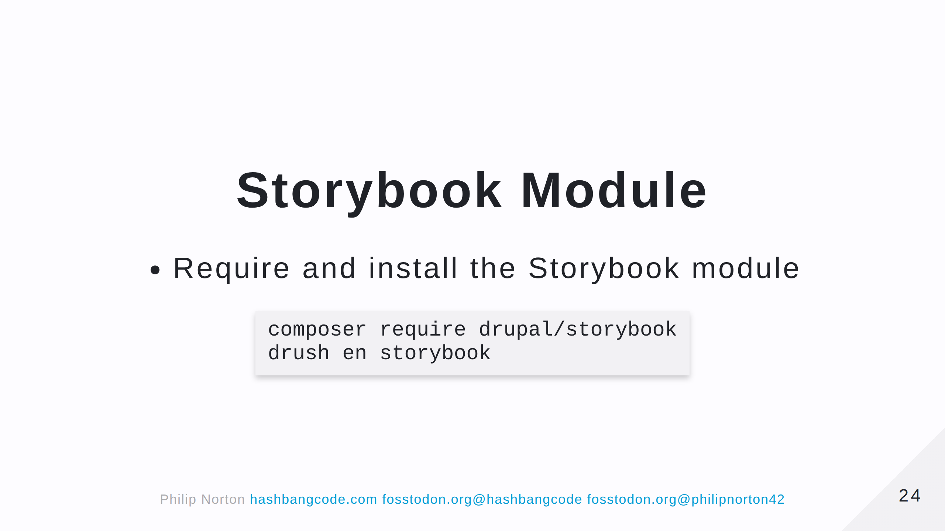

Slide 25
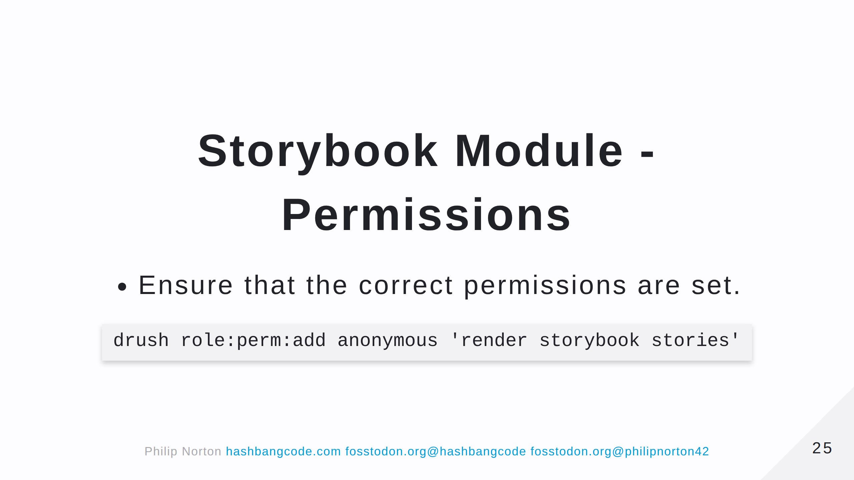

Slide 26
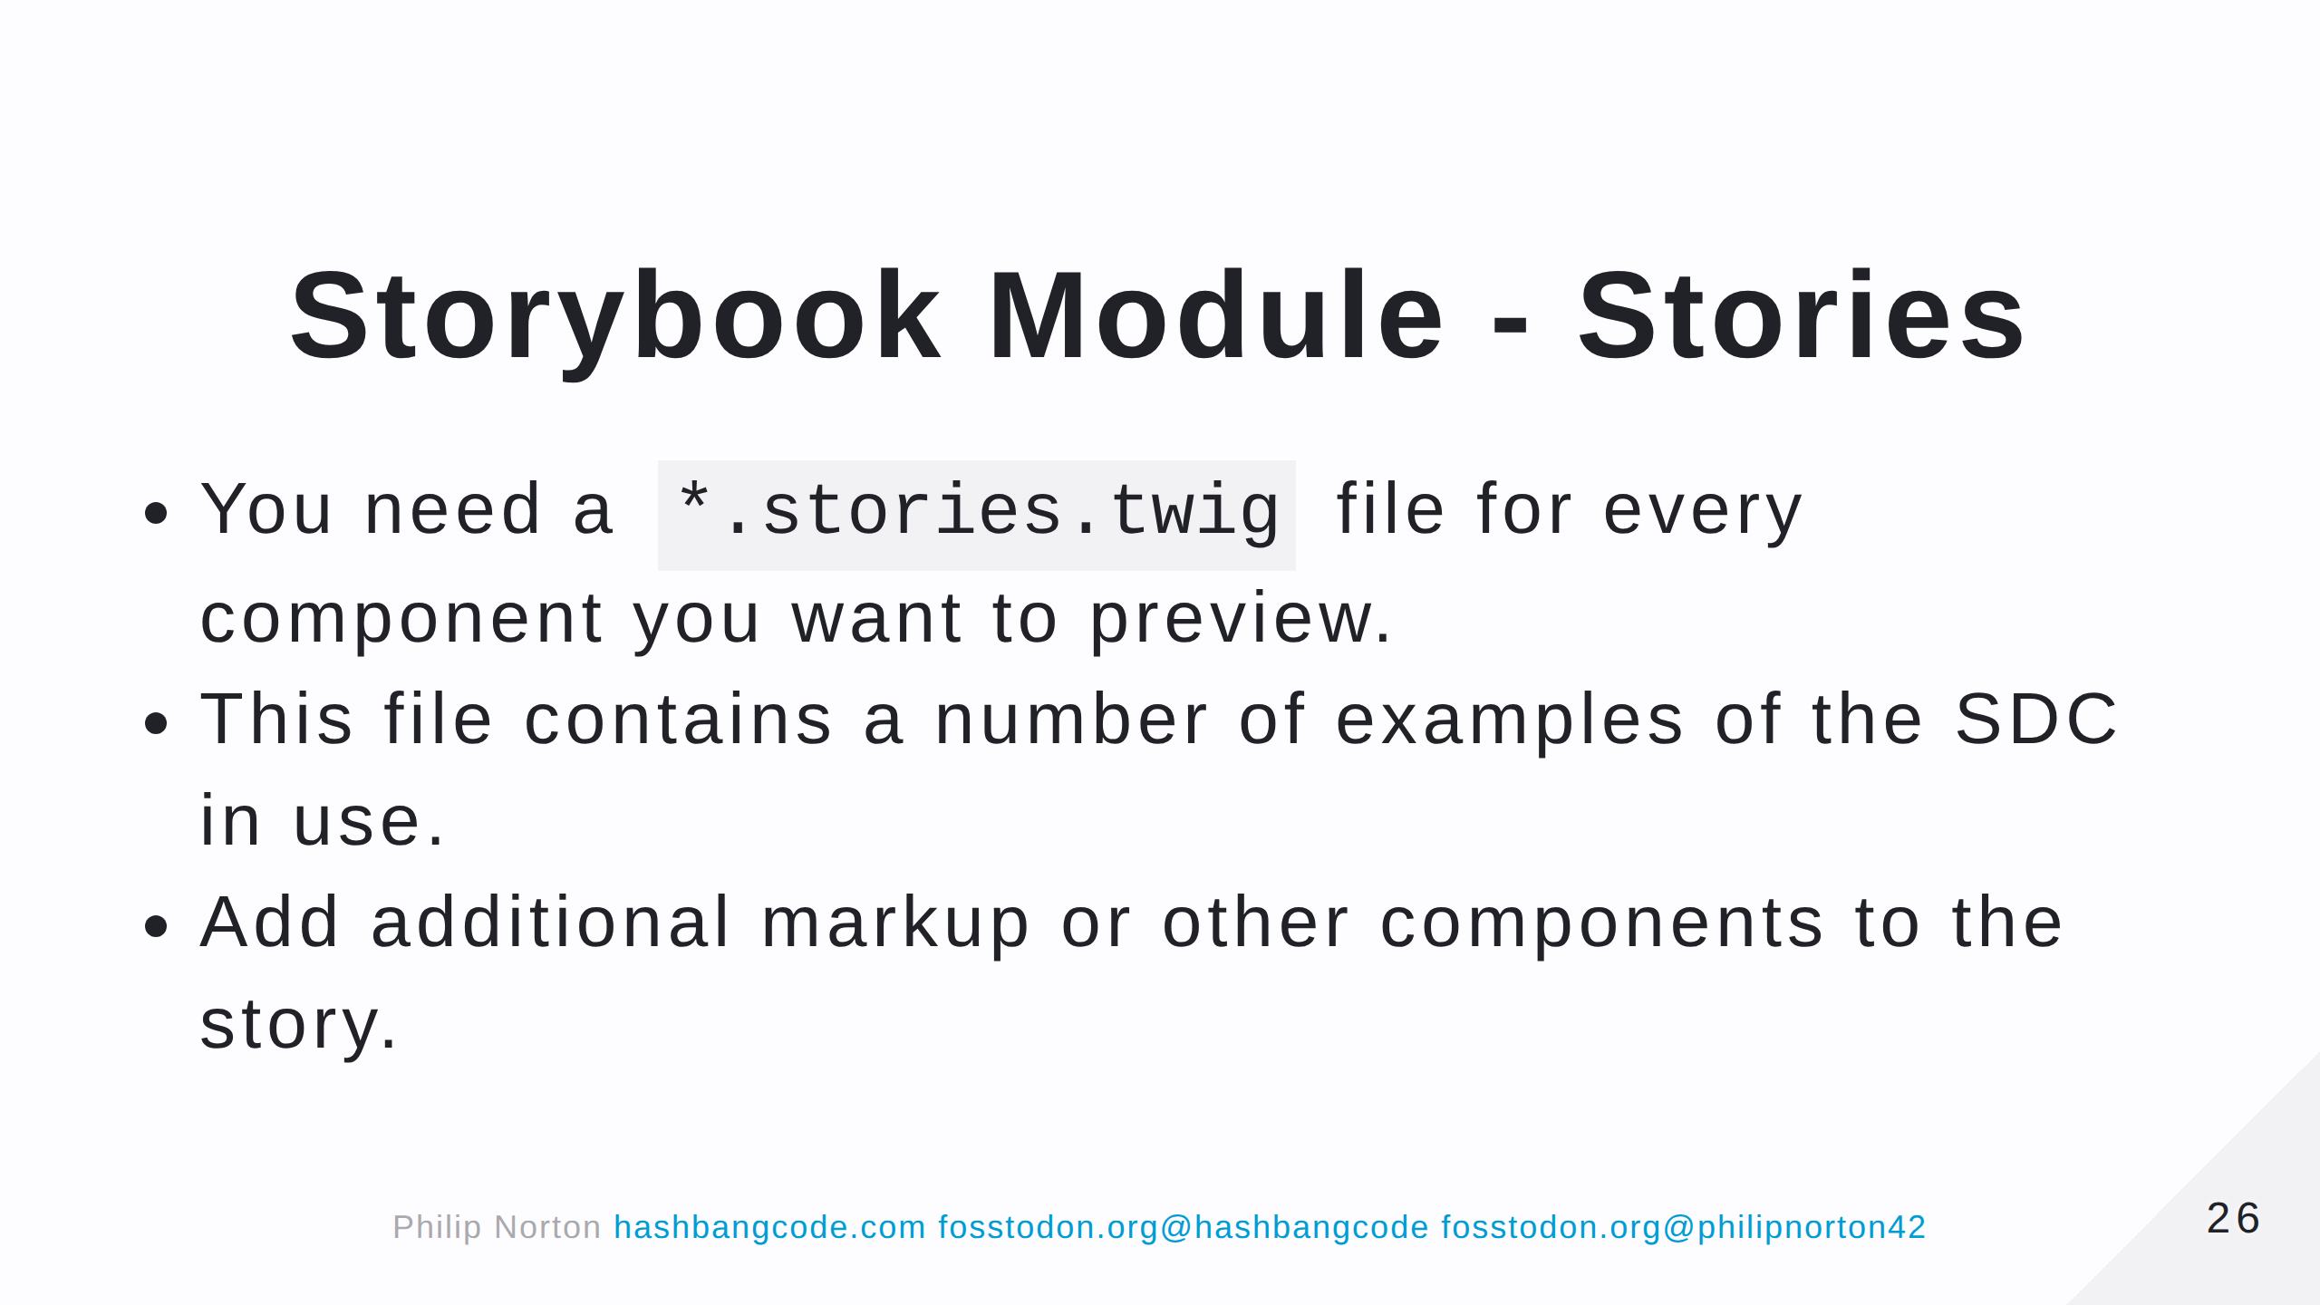

Slide 27
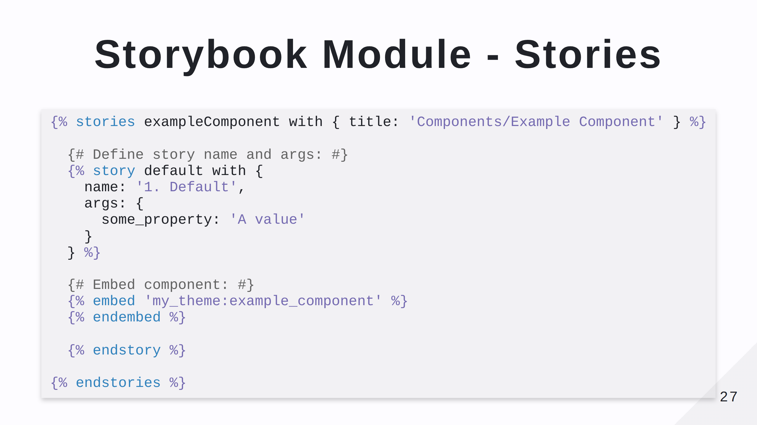

Slide 28
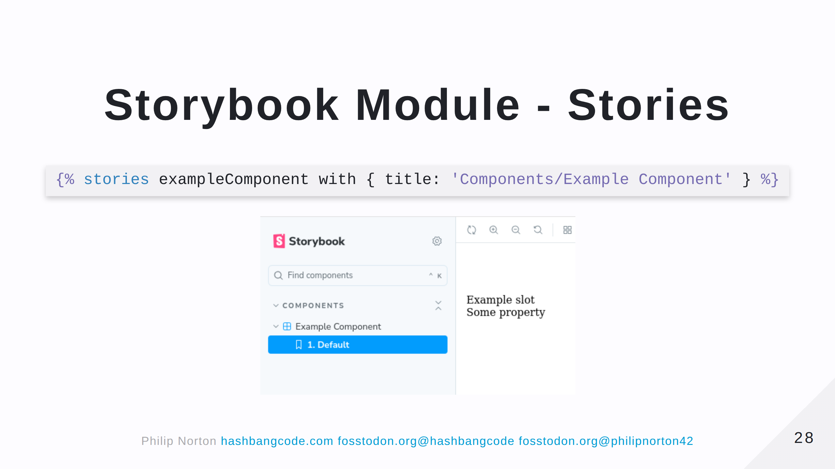

Slide 29
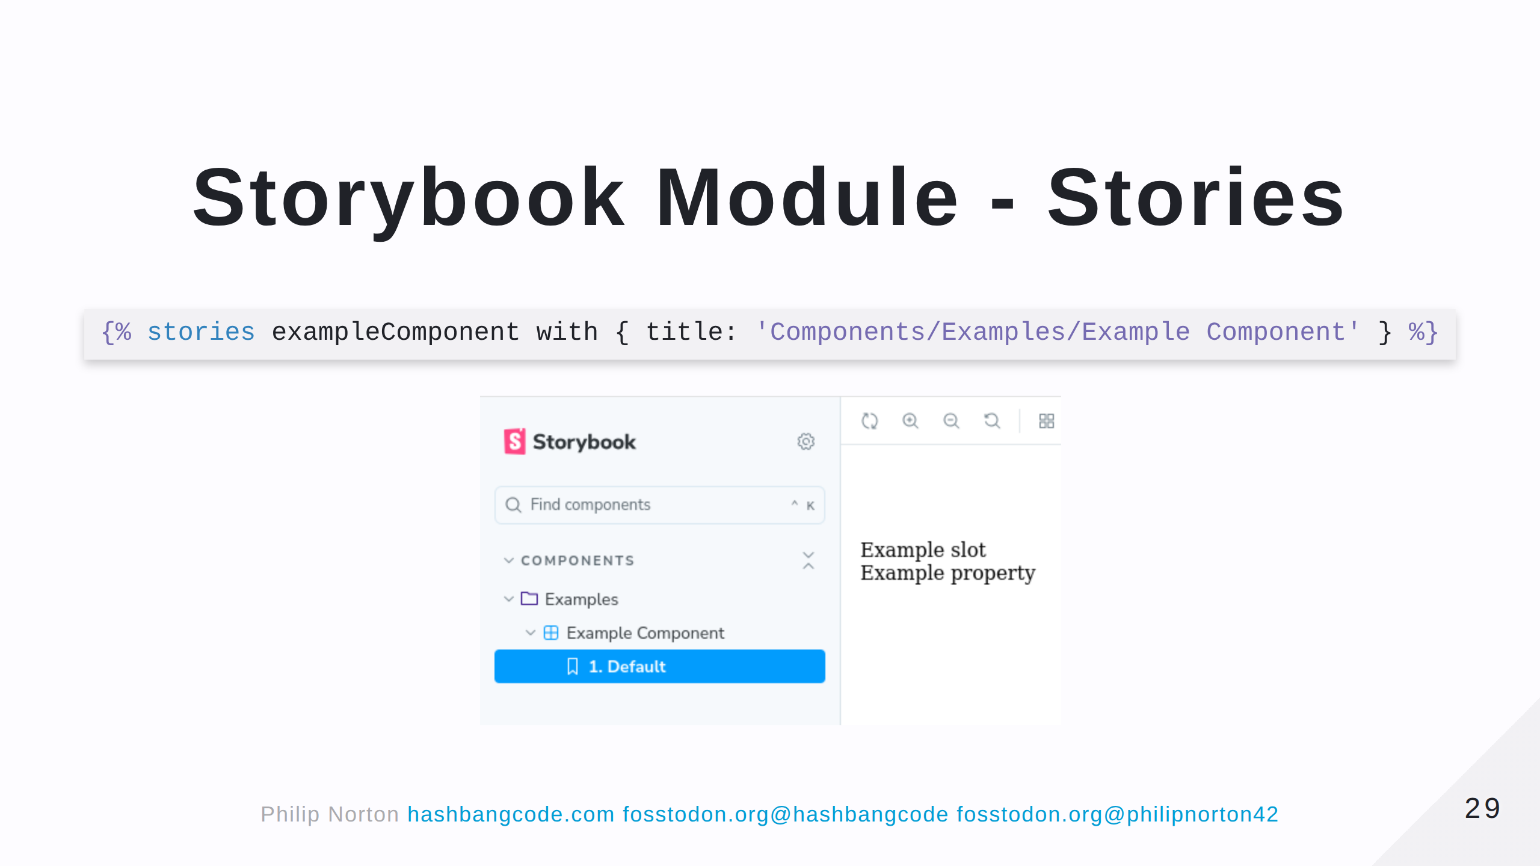

Slide 30
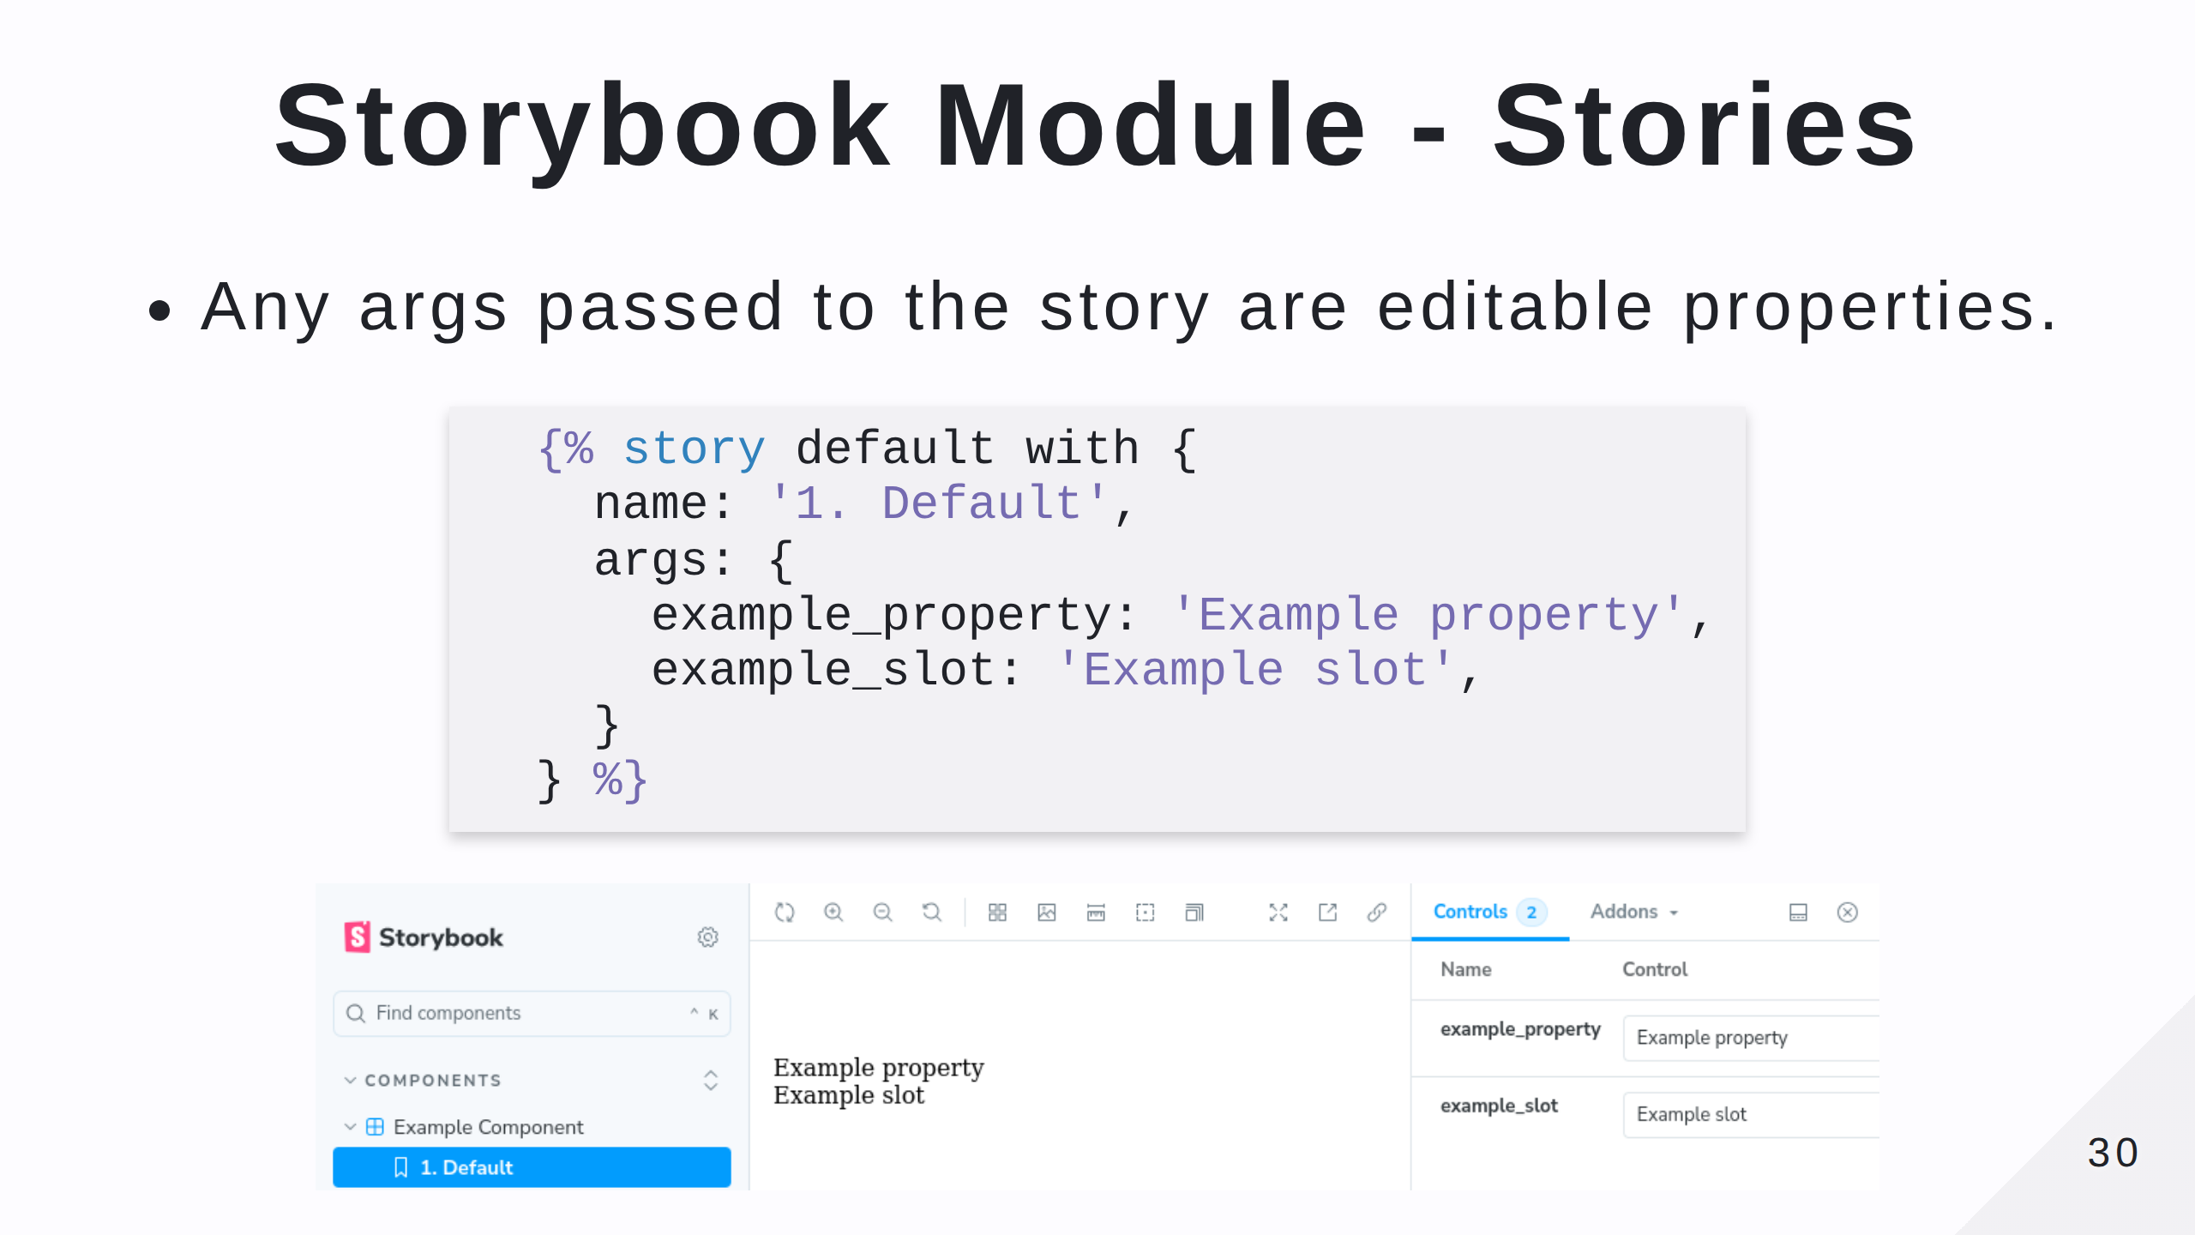

Slide 31
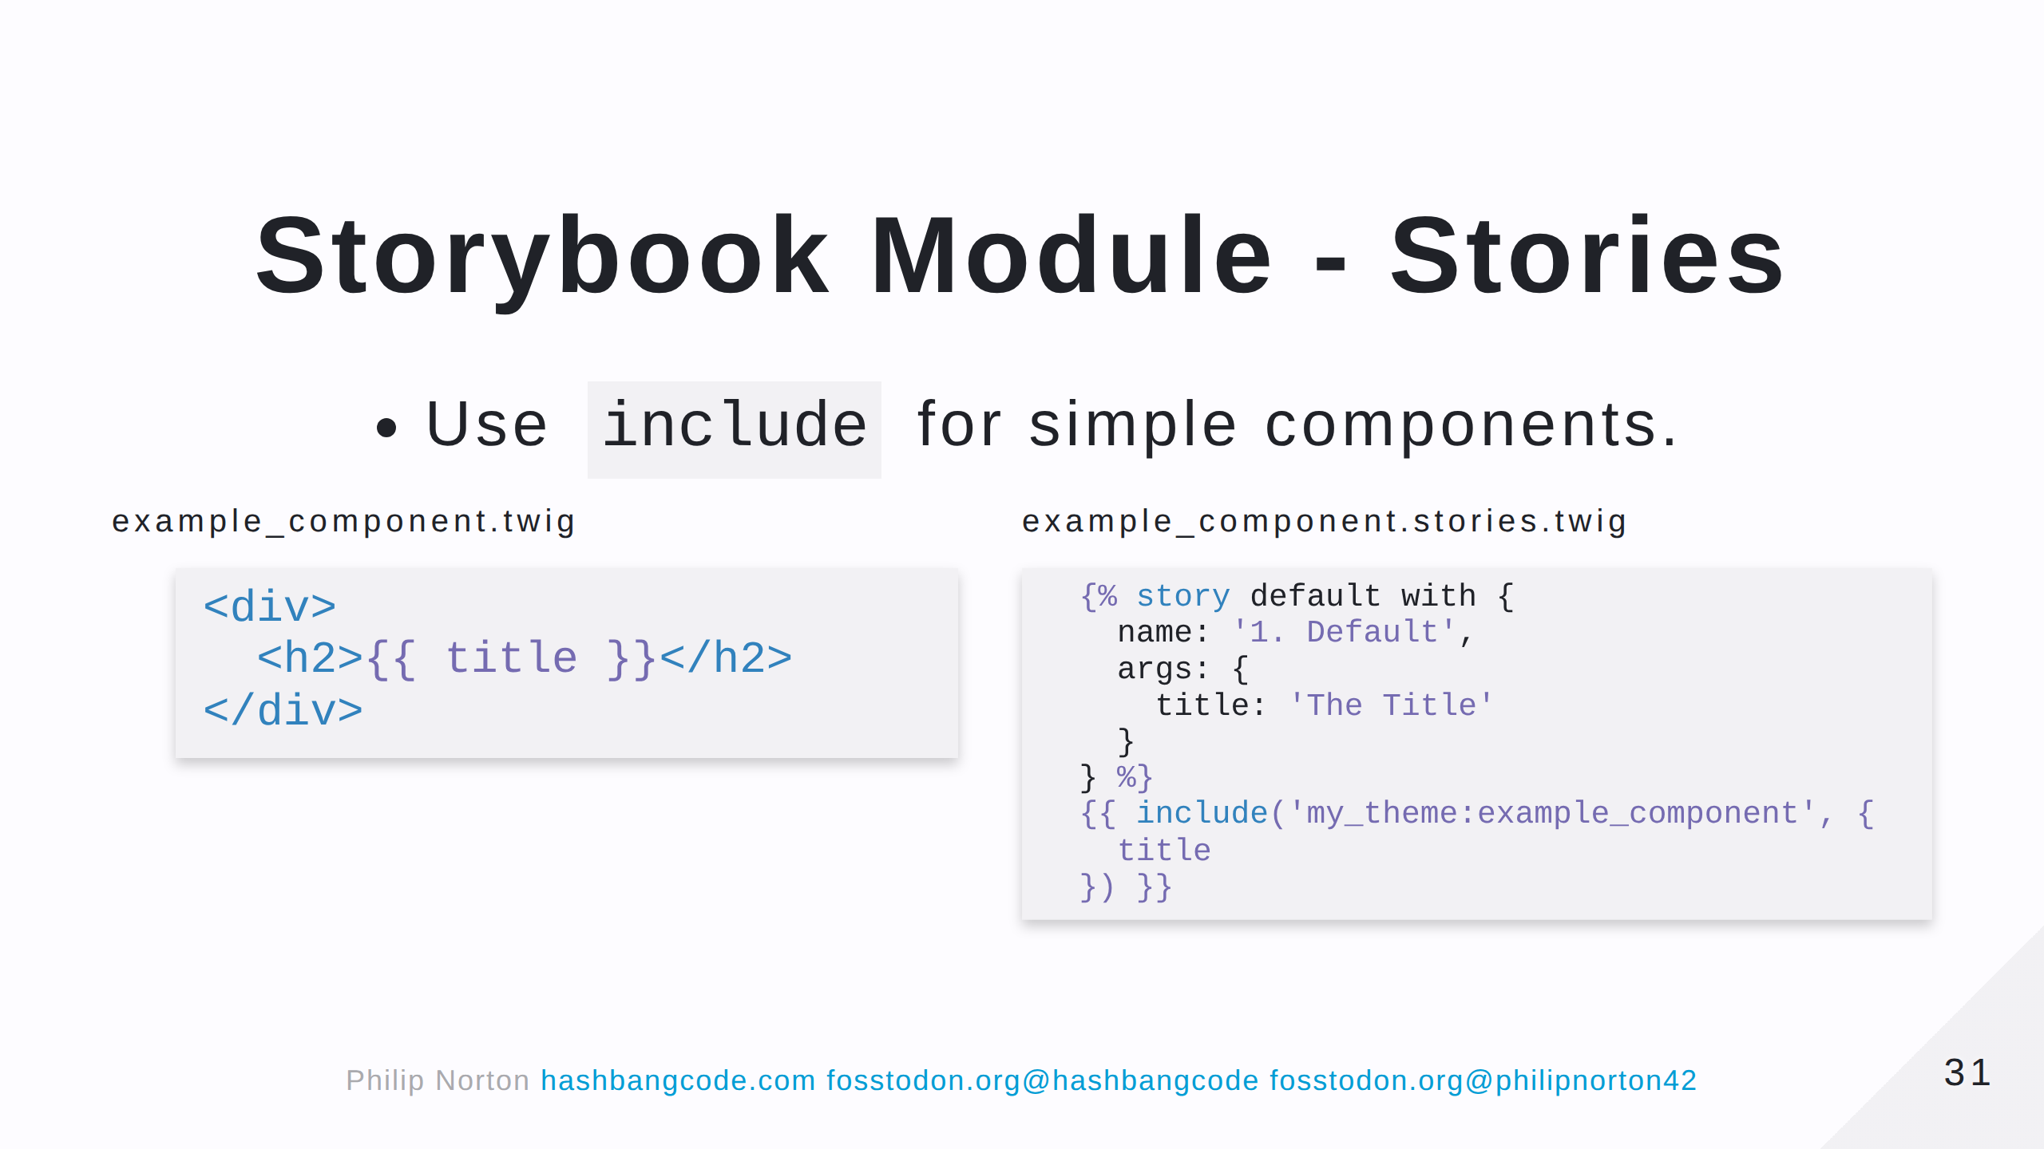

Slide 32
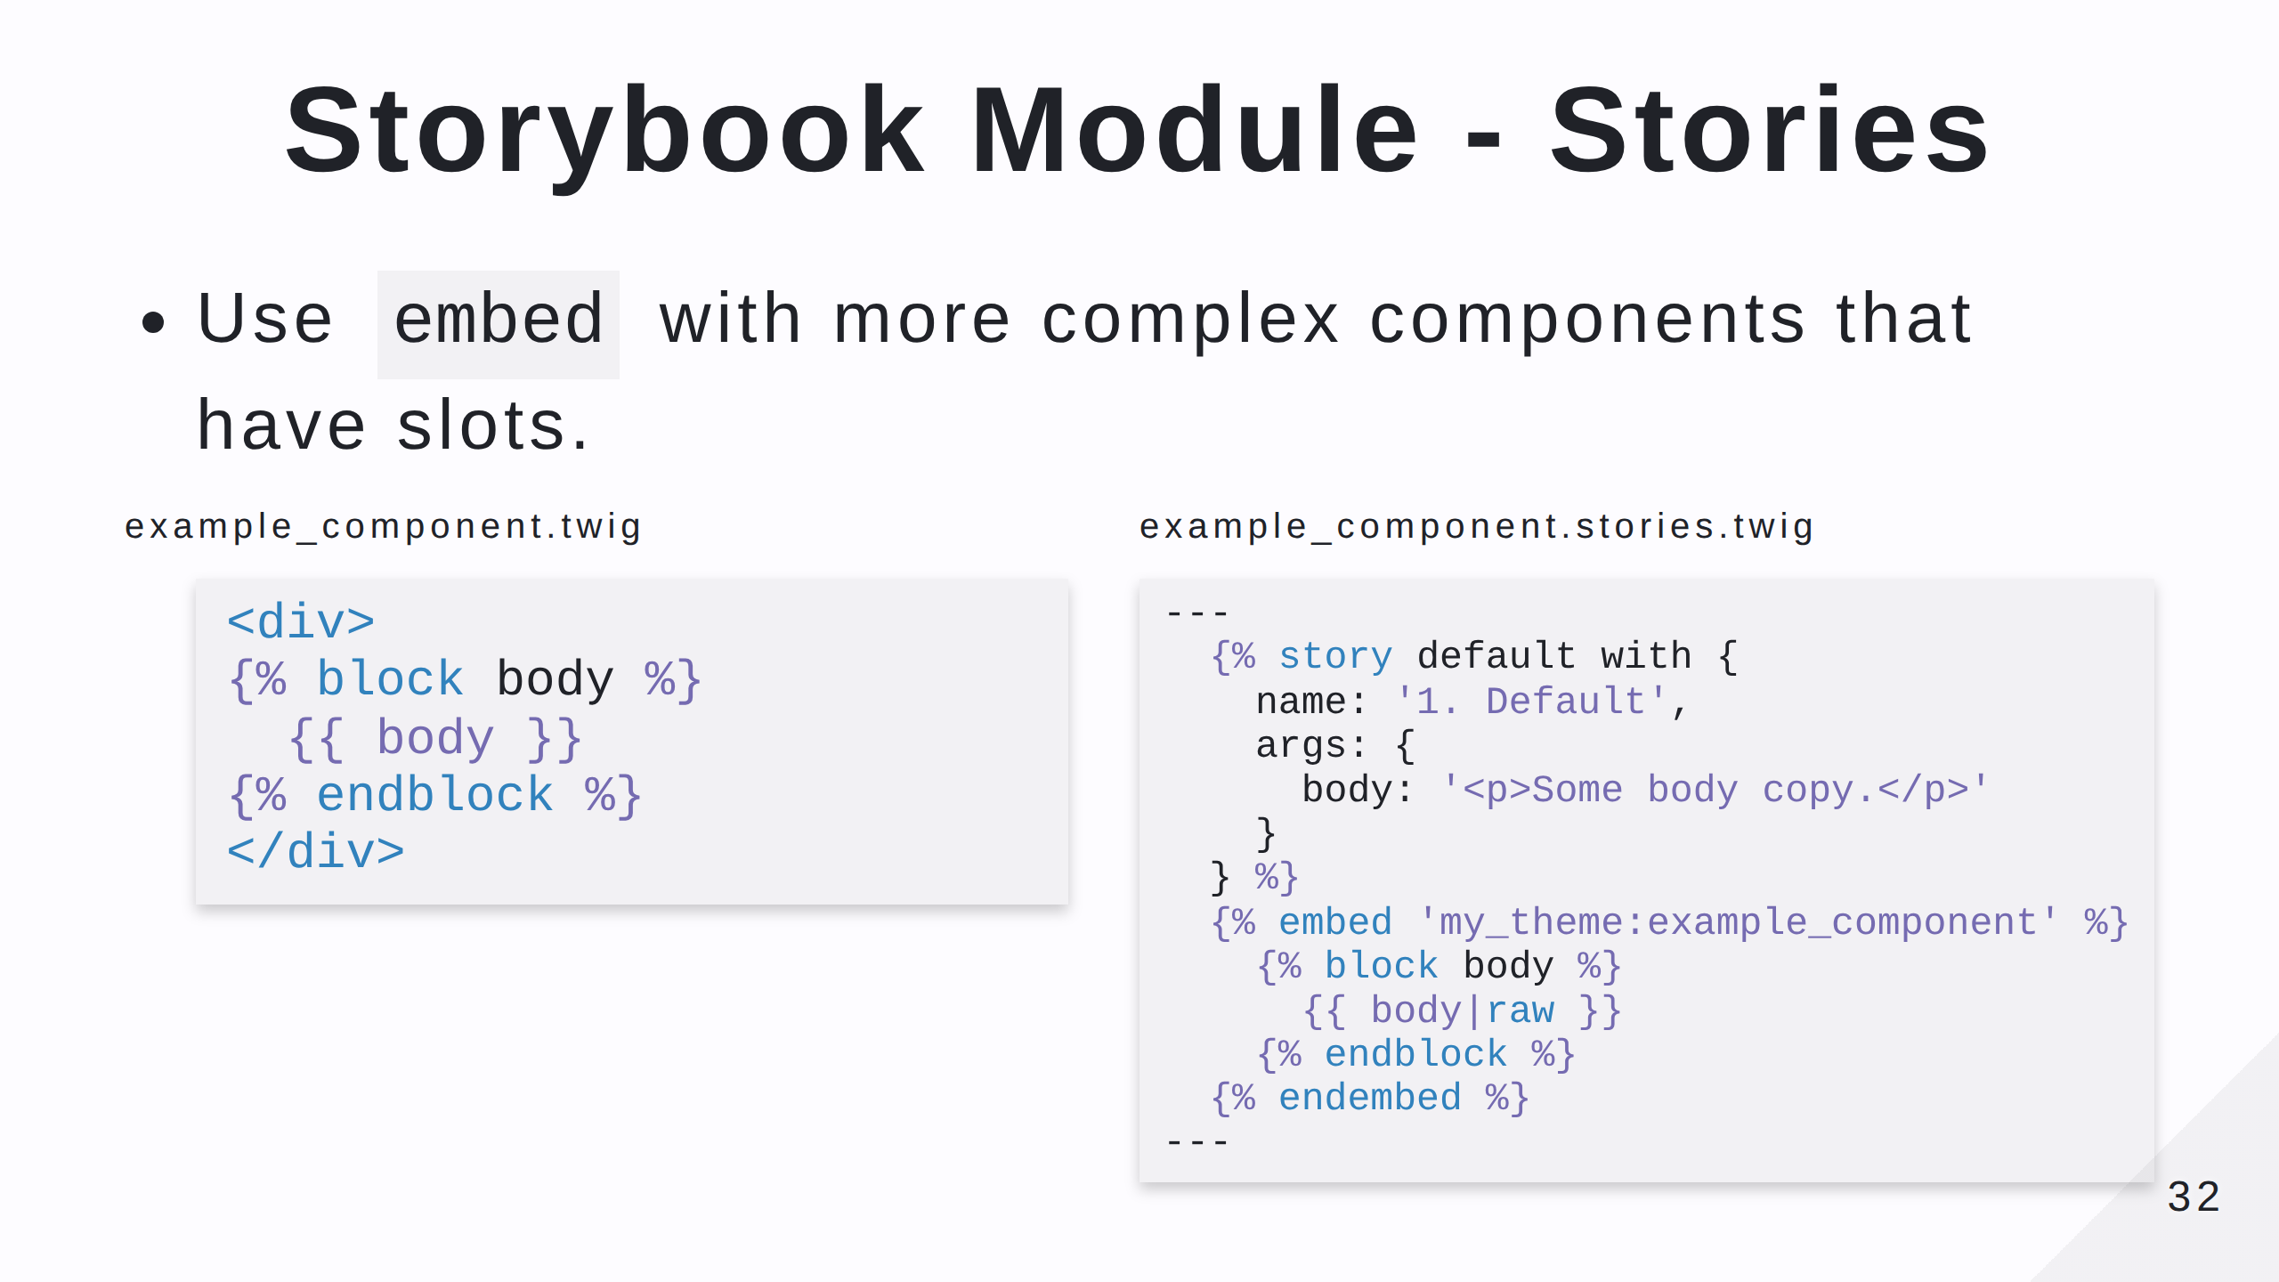
Notes:
Note that in this case any `props` we have defined will be passed to the template automatically.

Slide 33
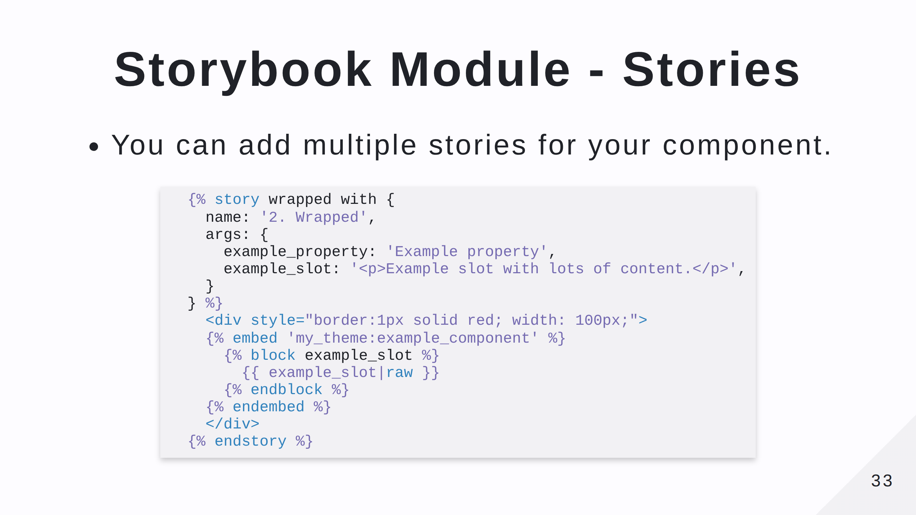
Notes:
This shows a second story where the element in question is wrapped in a restrictive red box. You can add stories to show different content for your component, but also think about the surrounding elements on the page. Adding in some example markup to show the component in situ can be really useful.

Slide 34
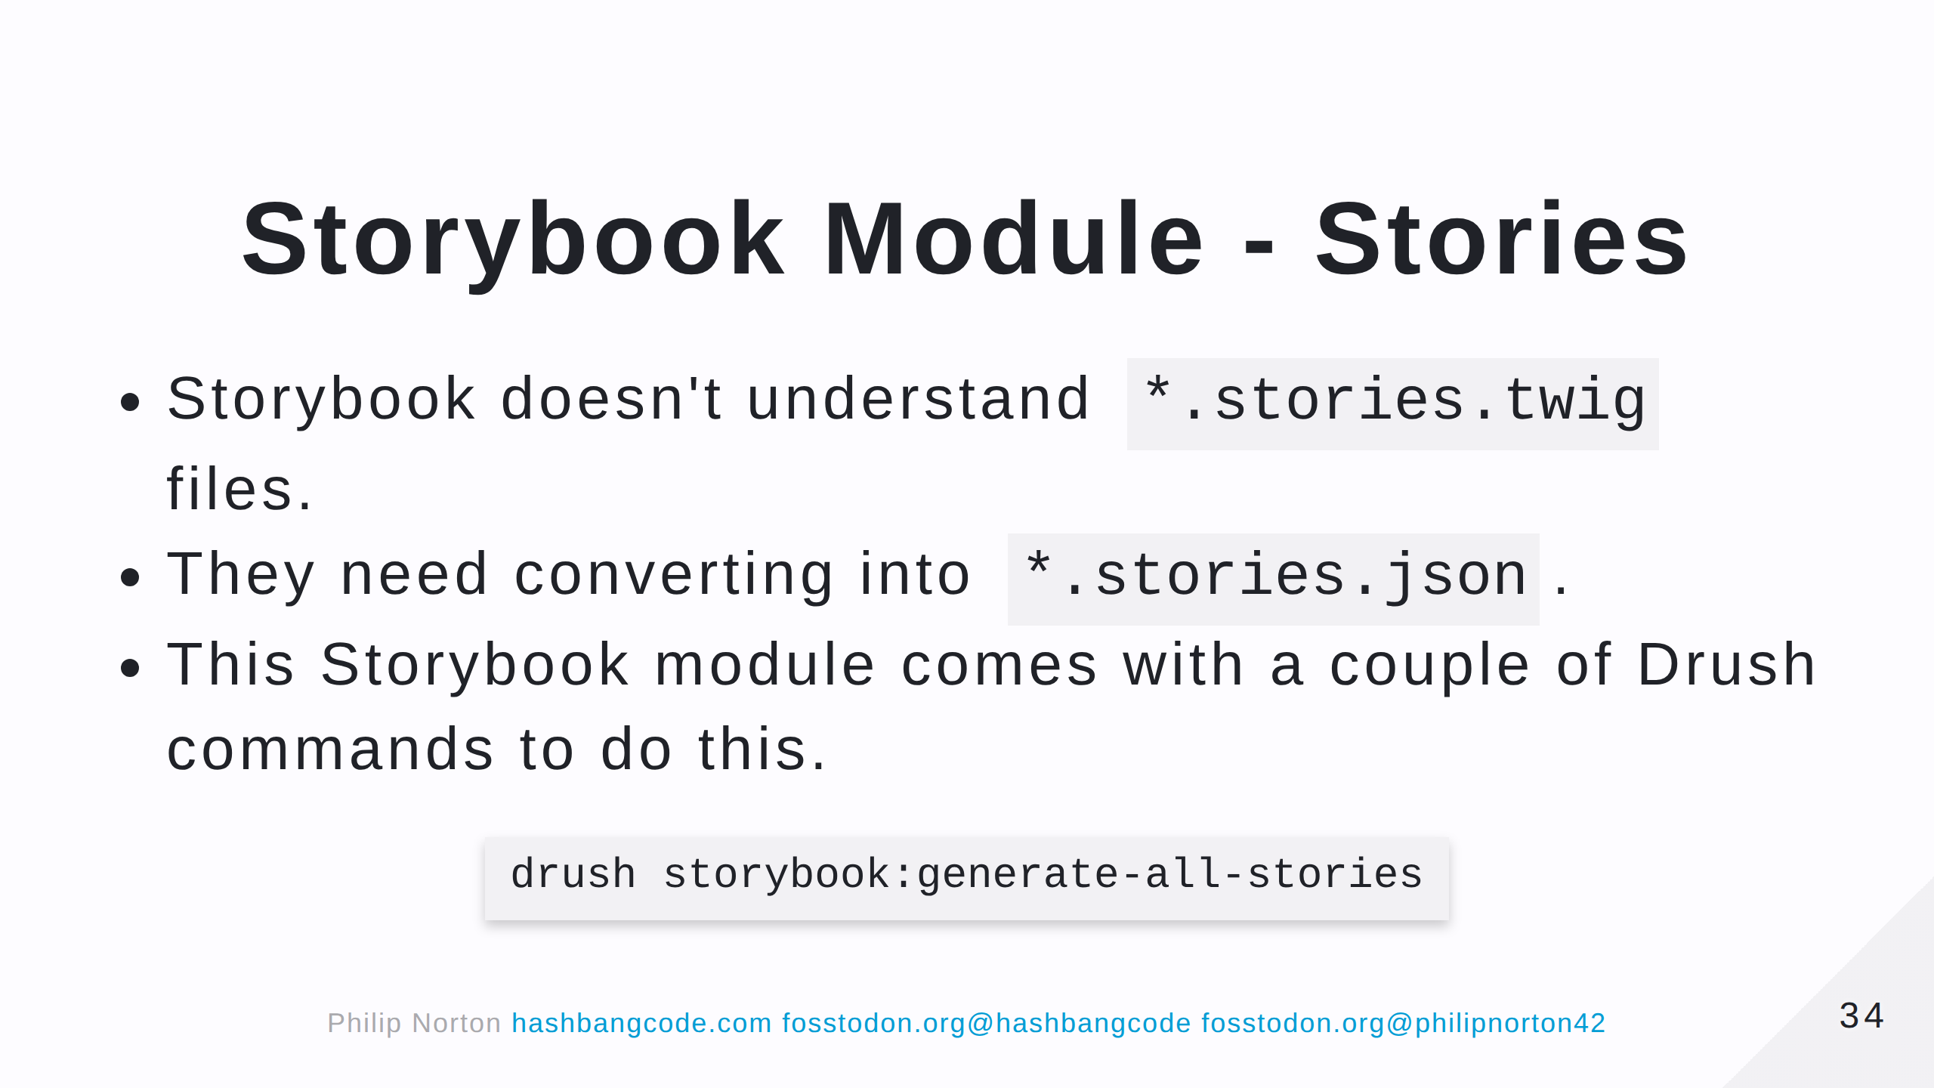

Slide 35
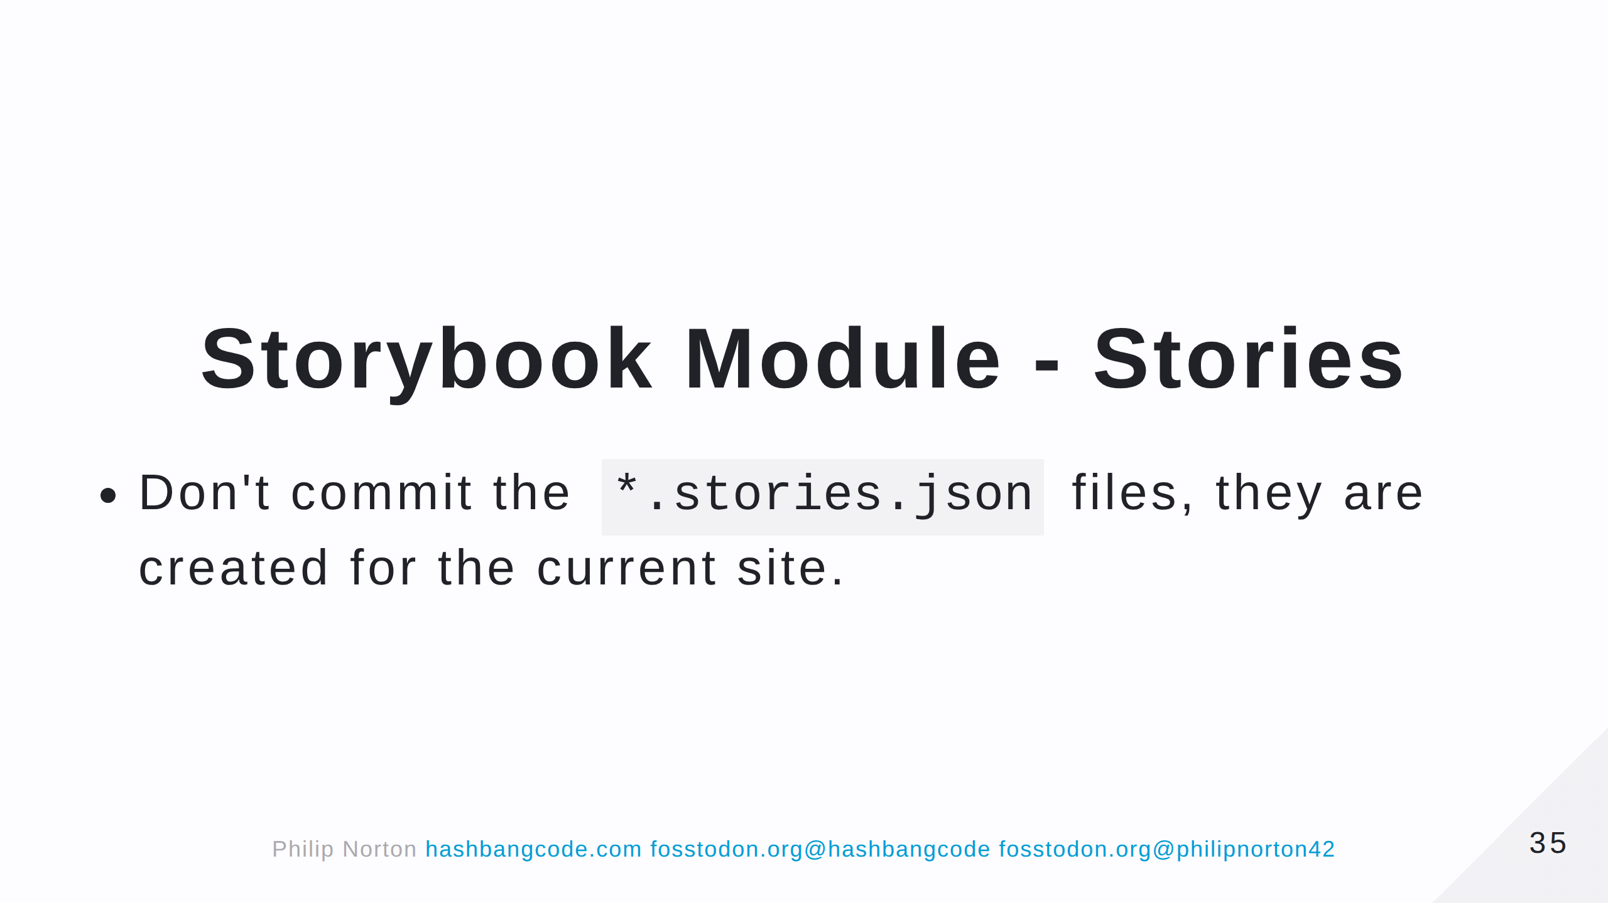

Slide 36
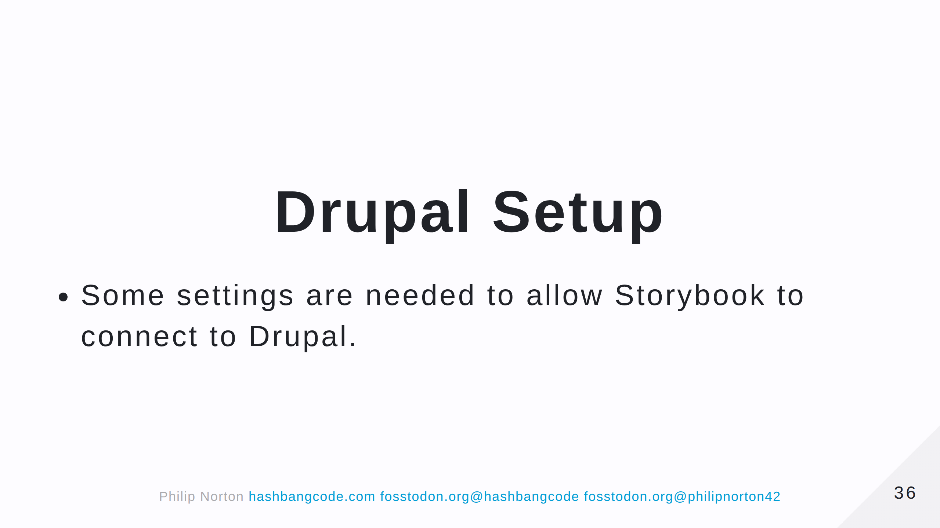

Slide 37
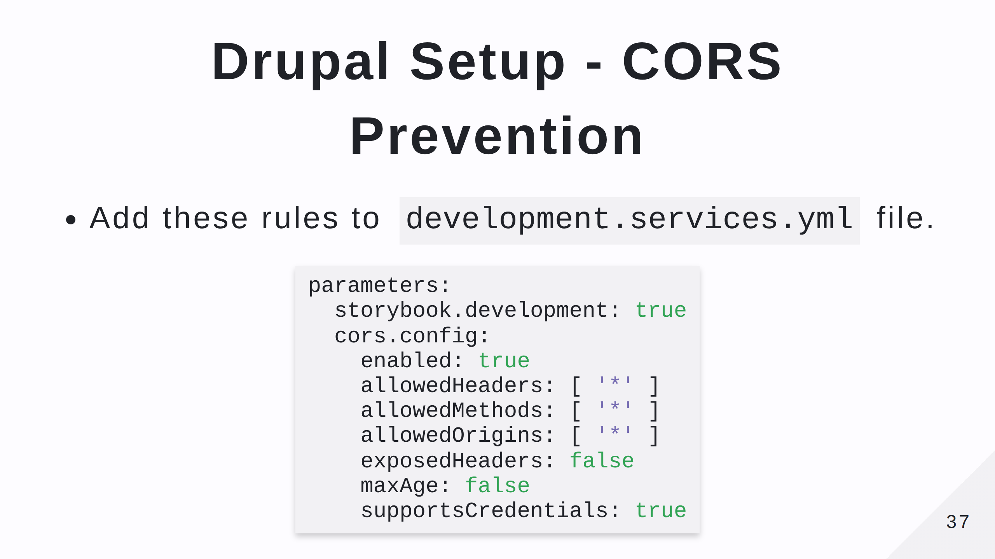
Notes:
CORS = Cross-Origin Resource Sharing Prevents websites from serving content to sites that they haven't previouly agreed to. This creates a problem when we do want to share content.

Slide 38
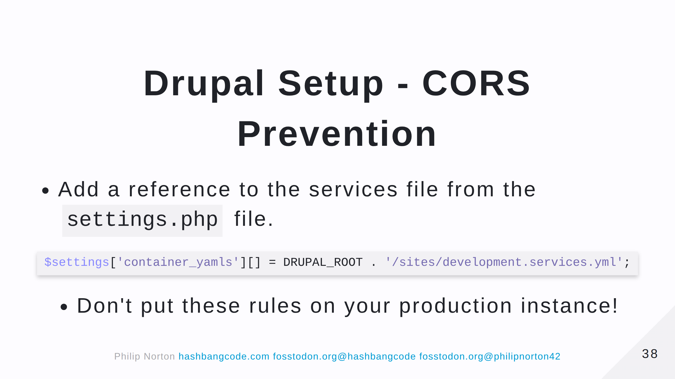

Slide 39
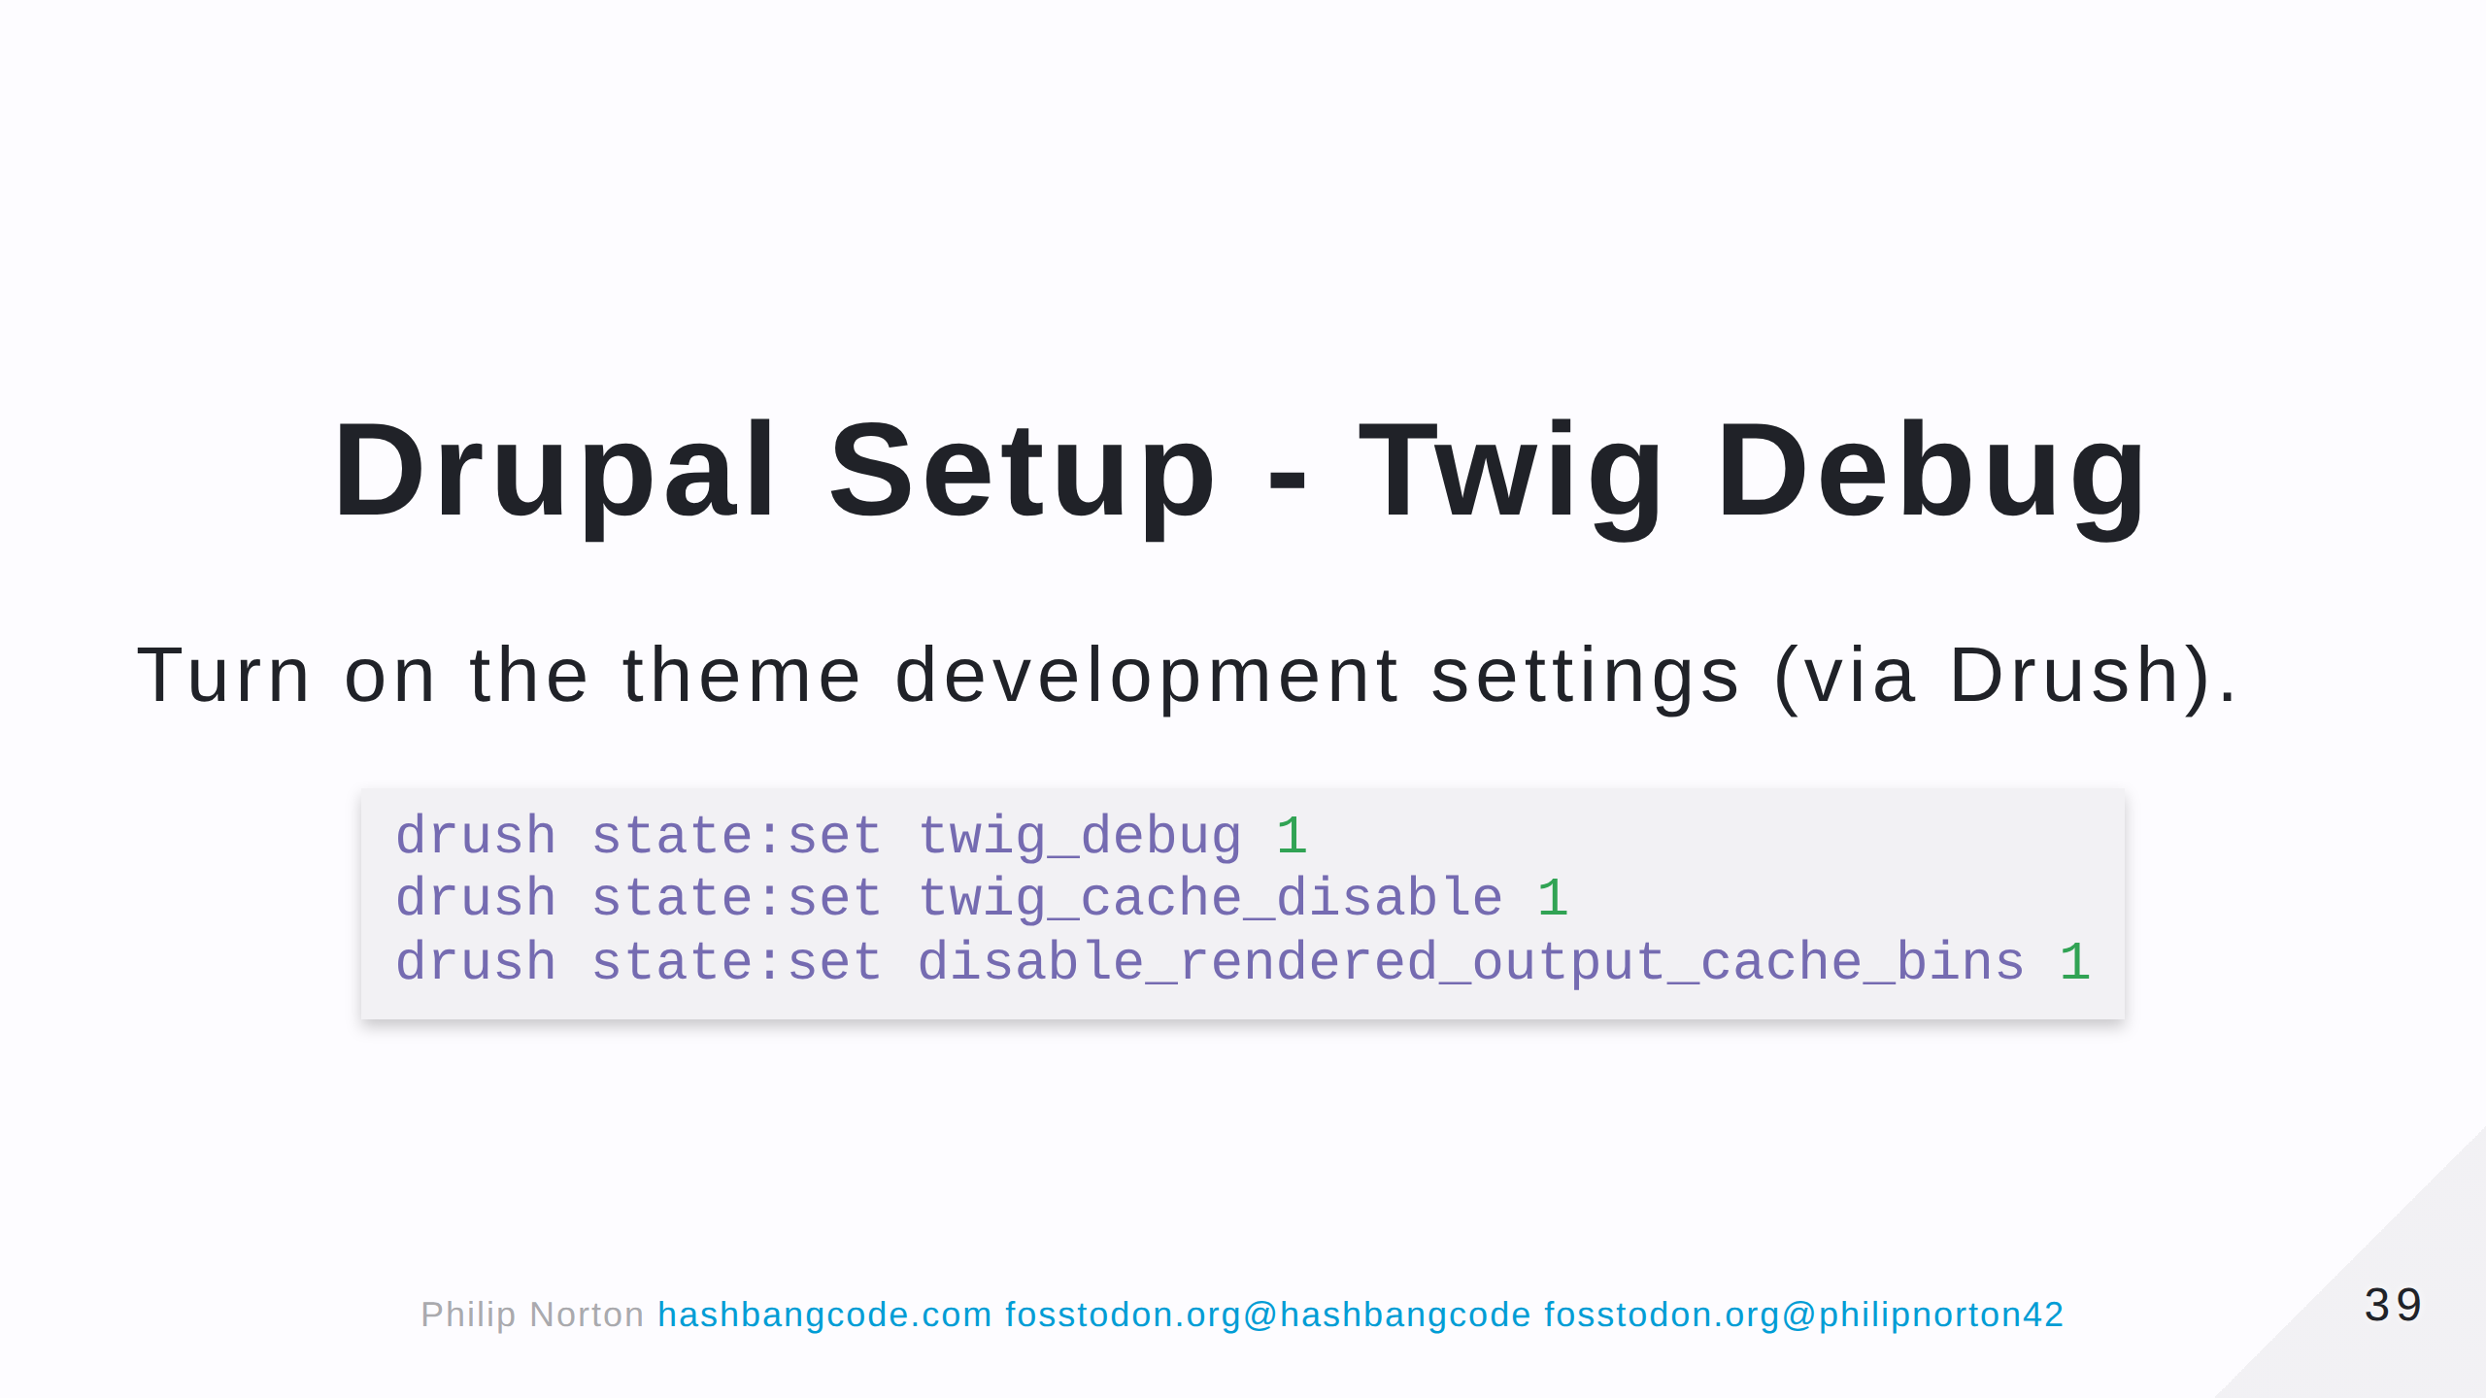

Slide 40
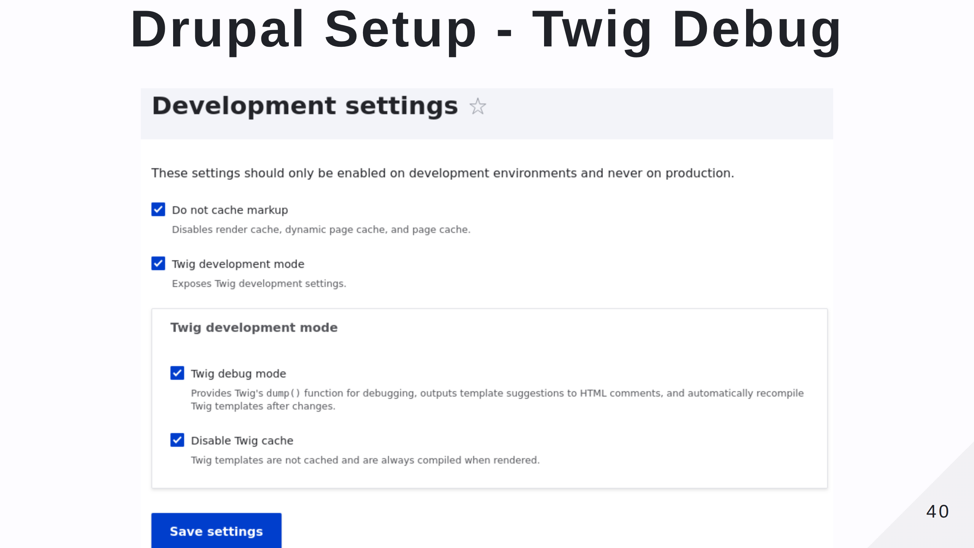

Slide 41
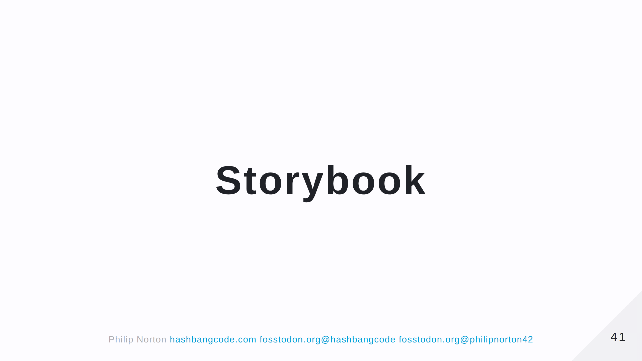

Slide 42
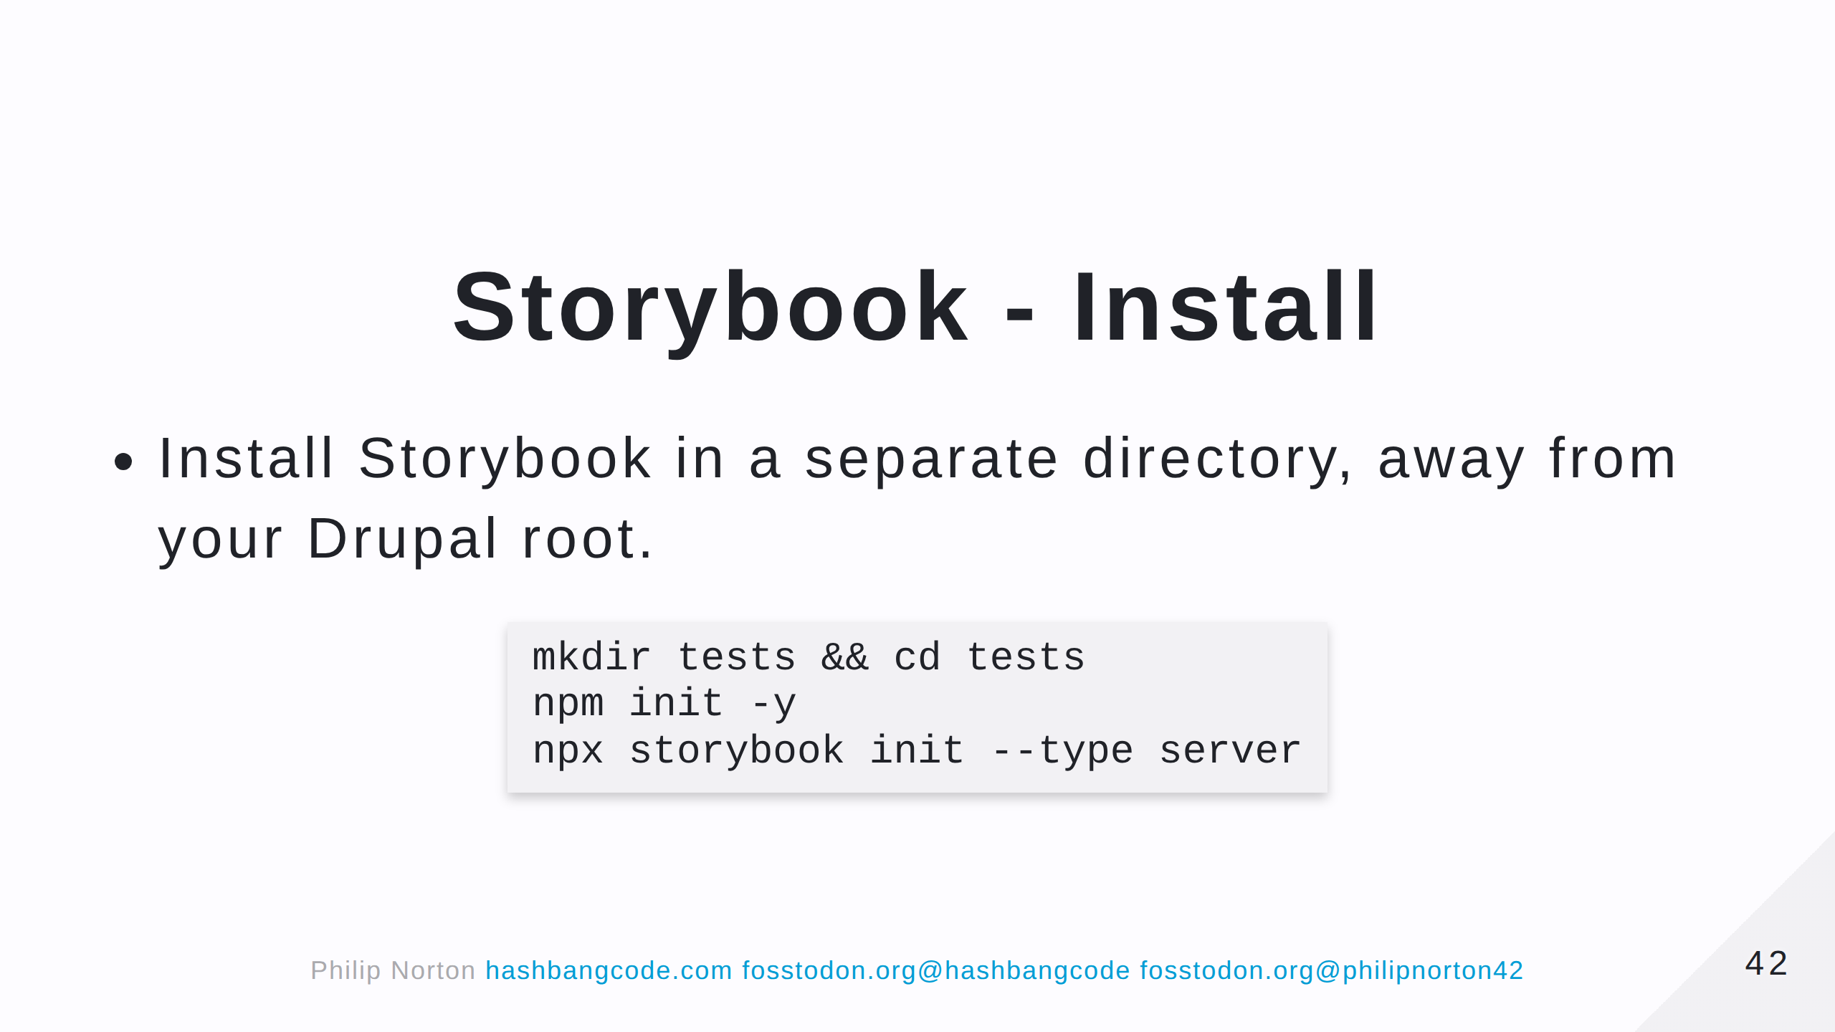

Slide 43
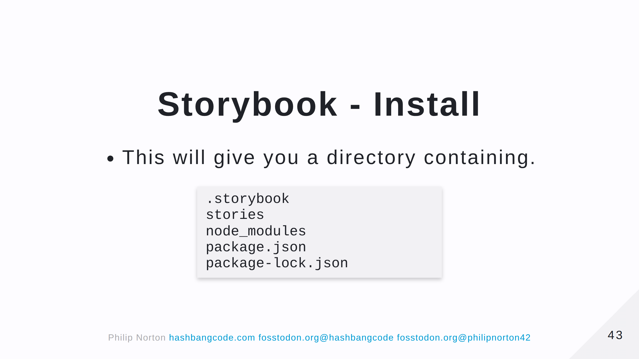
Notes:
- .storybook is the storybook configuration directory. - stories contains some example stories. - The other directories are standard node directories.

Slide 44
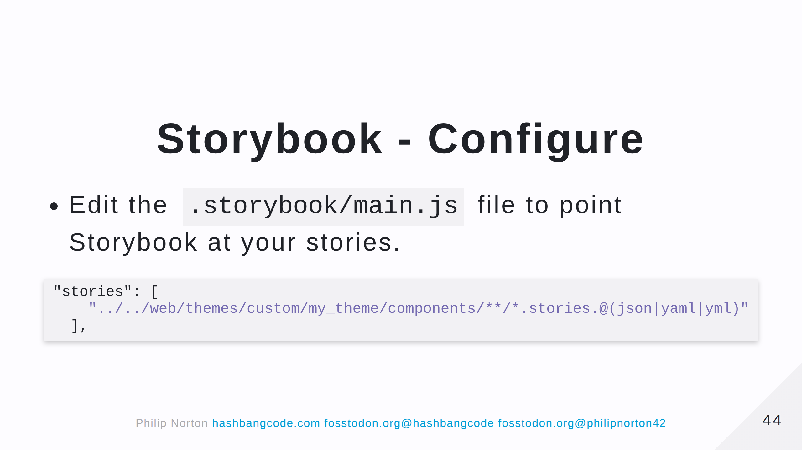
Notes:
Remember that you can have stories in themes and modules, so you can have multiple lines here pointing at different directories. The modules and themes don't need to be active, as long as they have a *.stories.twig

Slide 45
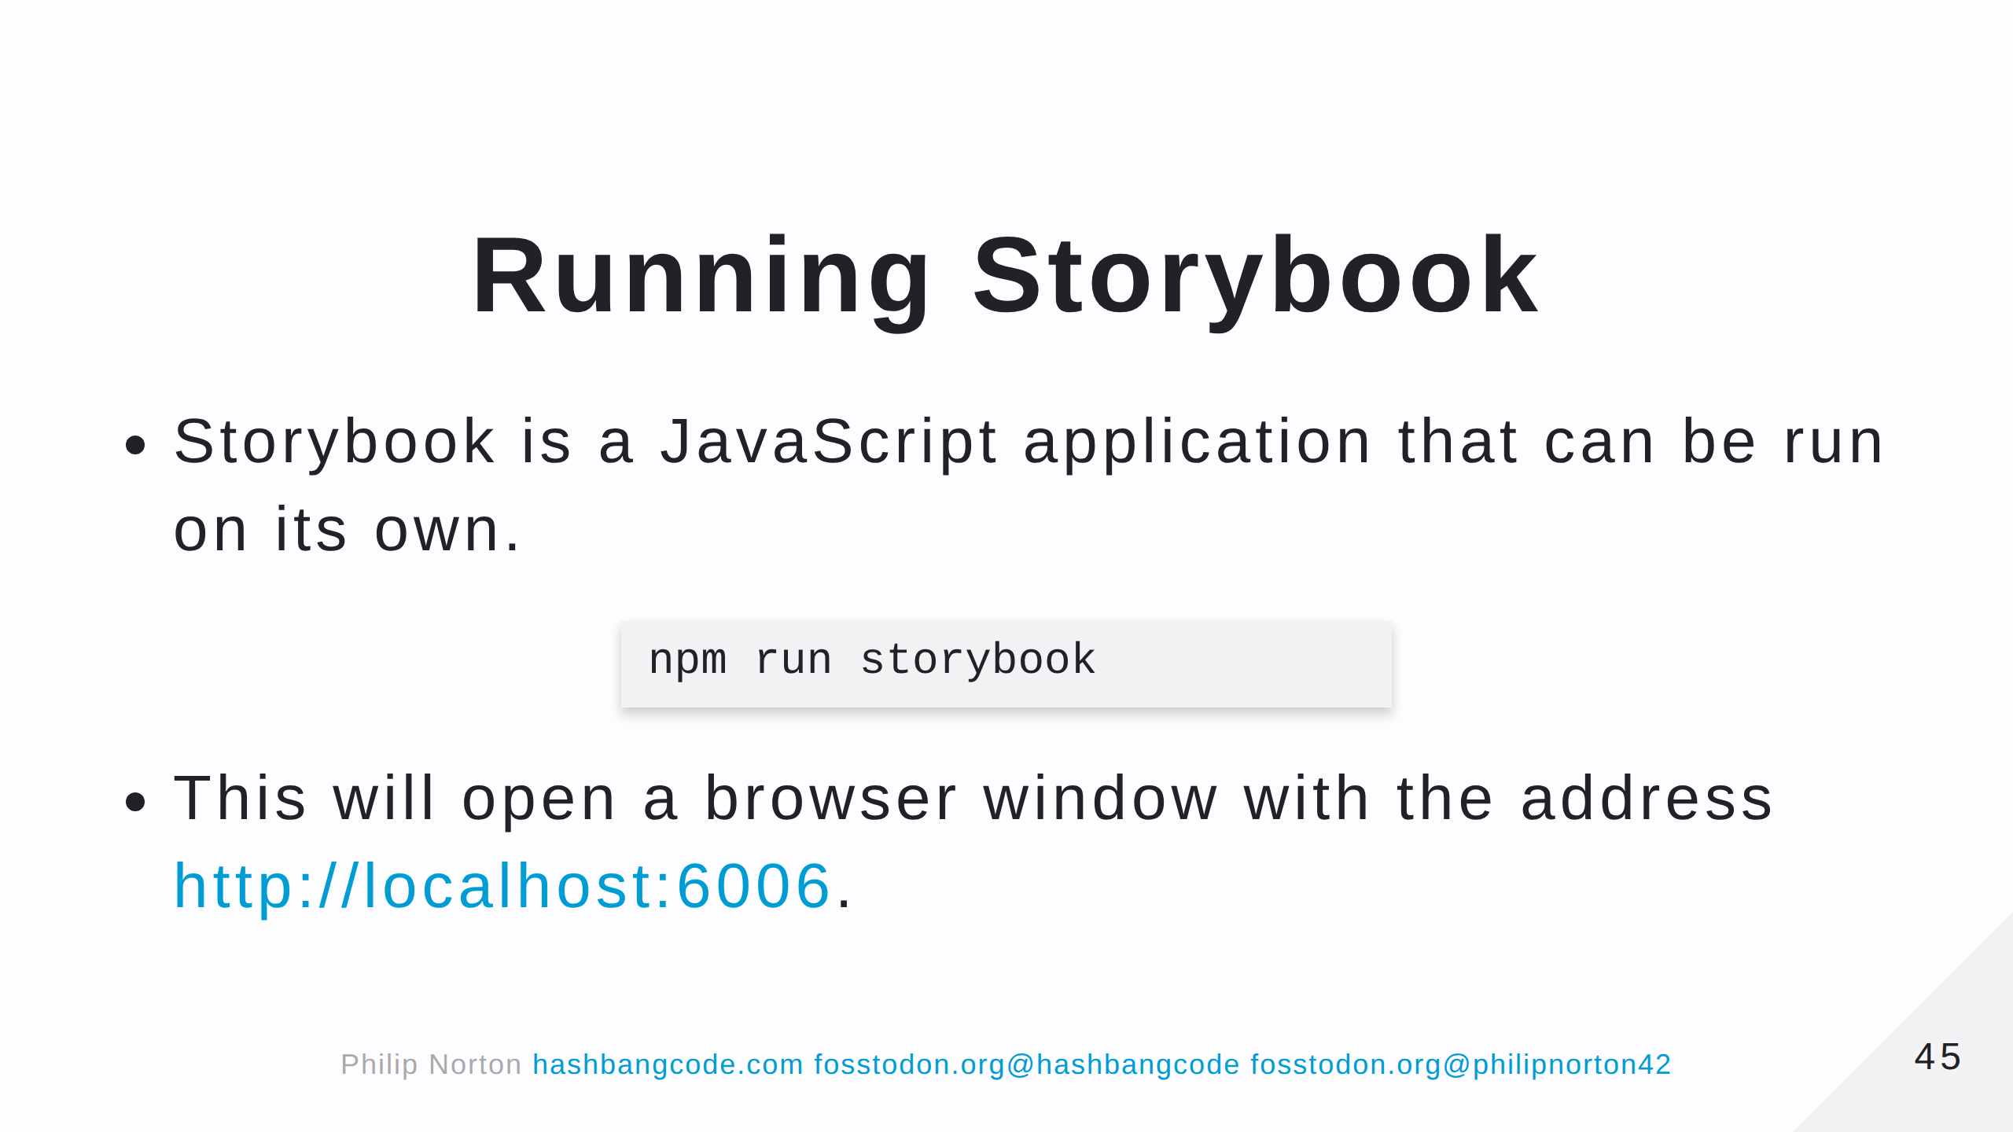

Slide 46
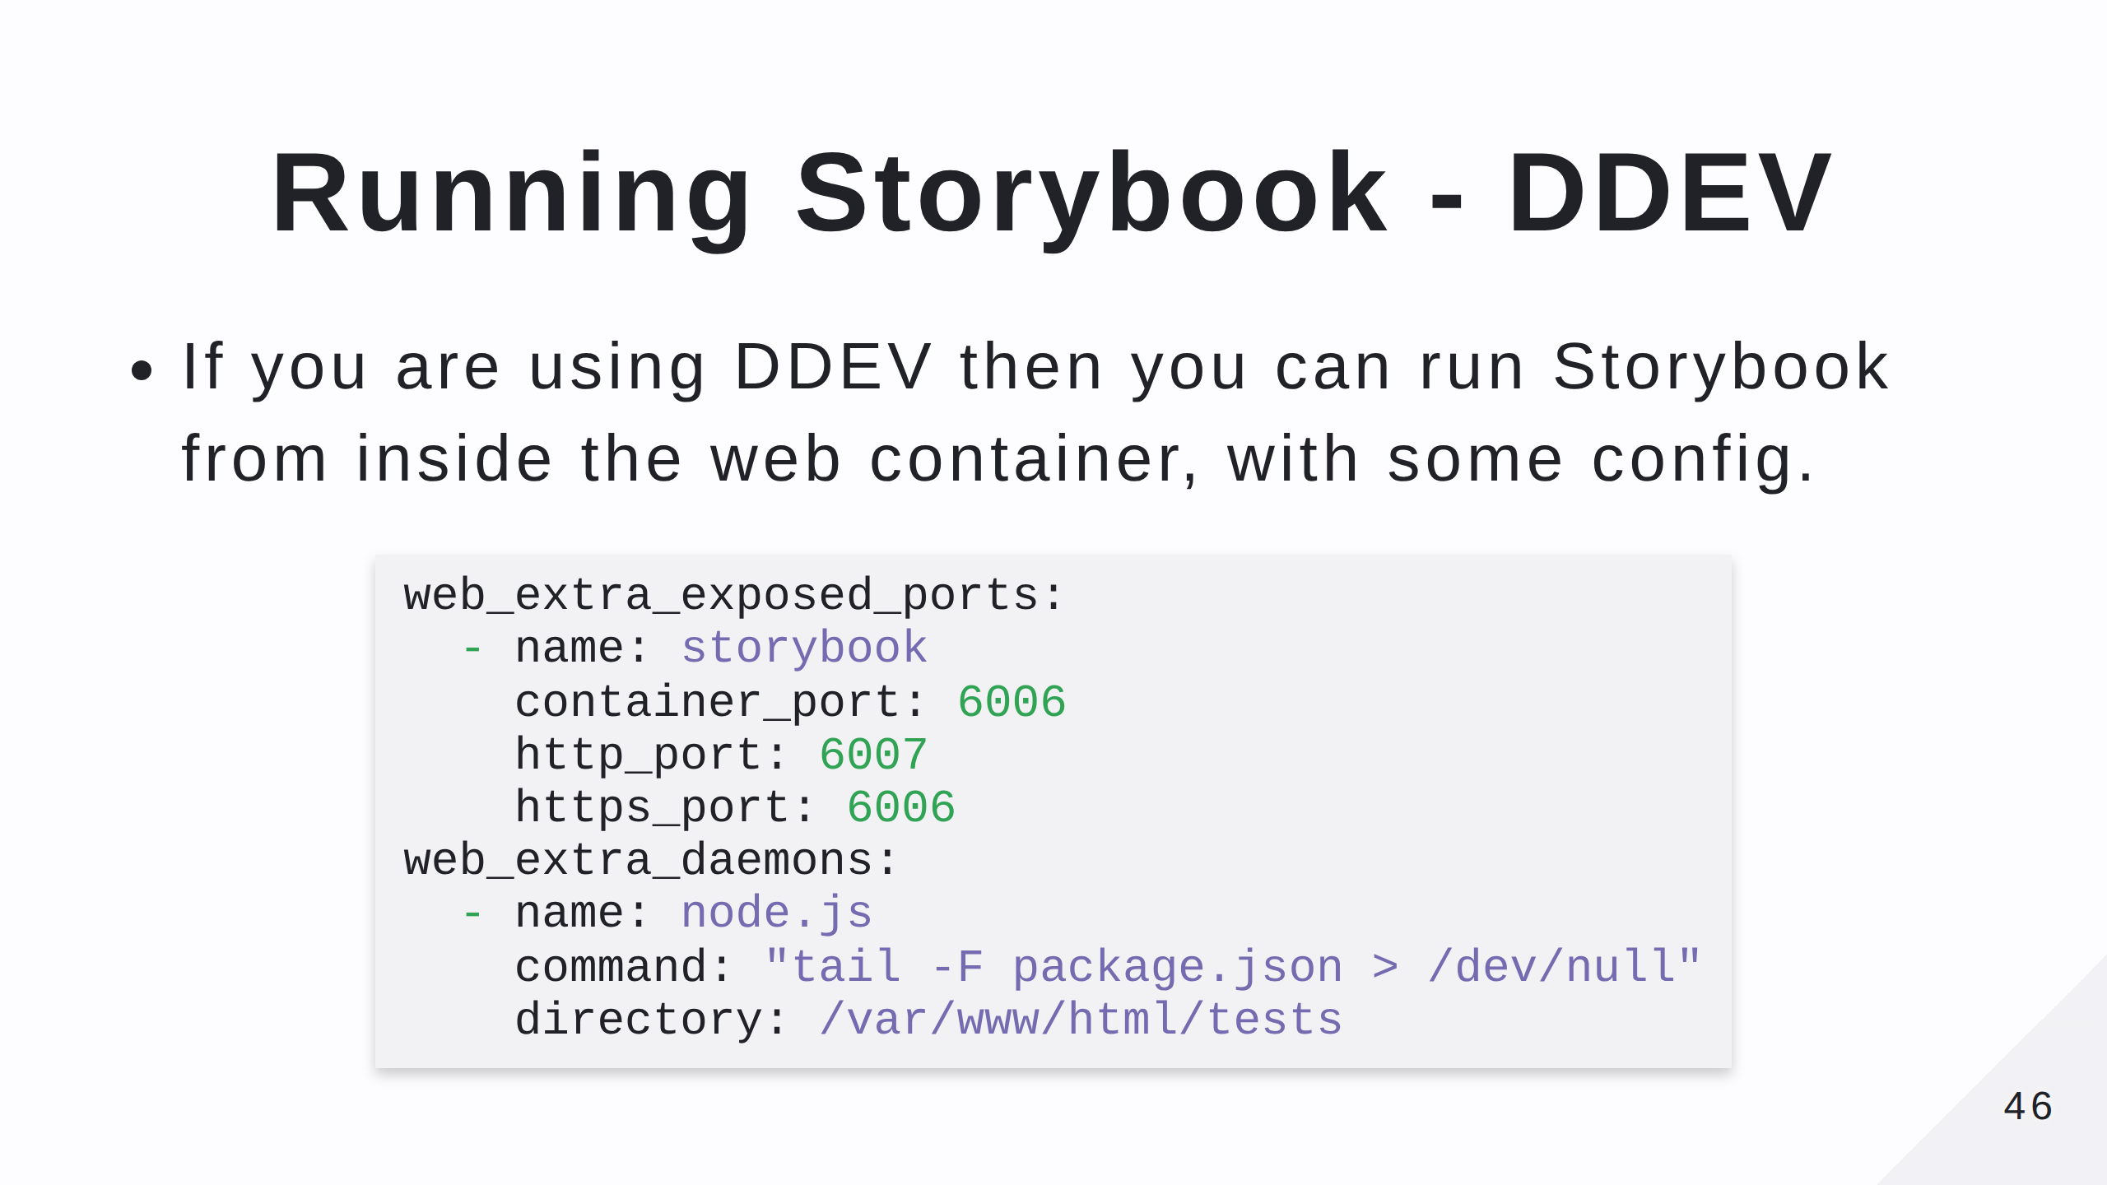
Notes:
Add this to your .ddev/config.yml file and restart ddev.

Slide 47
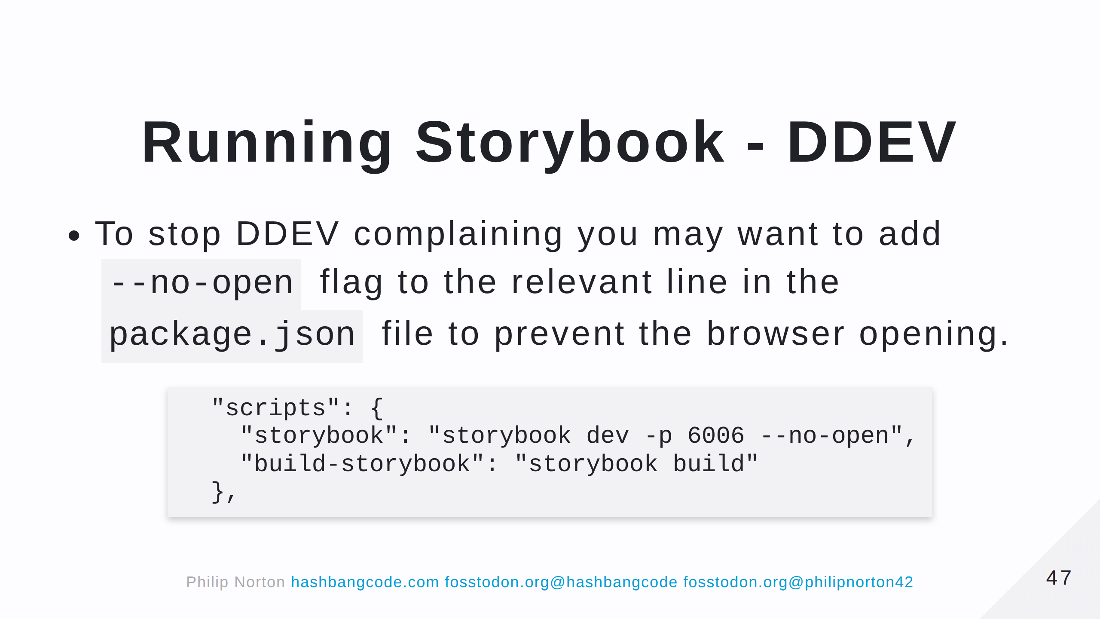

Slide 48
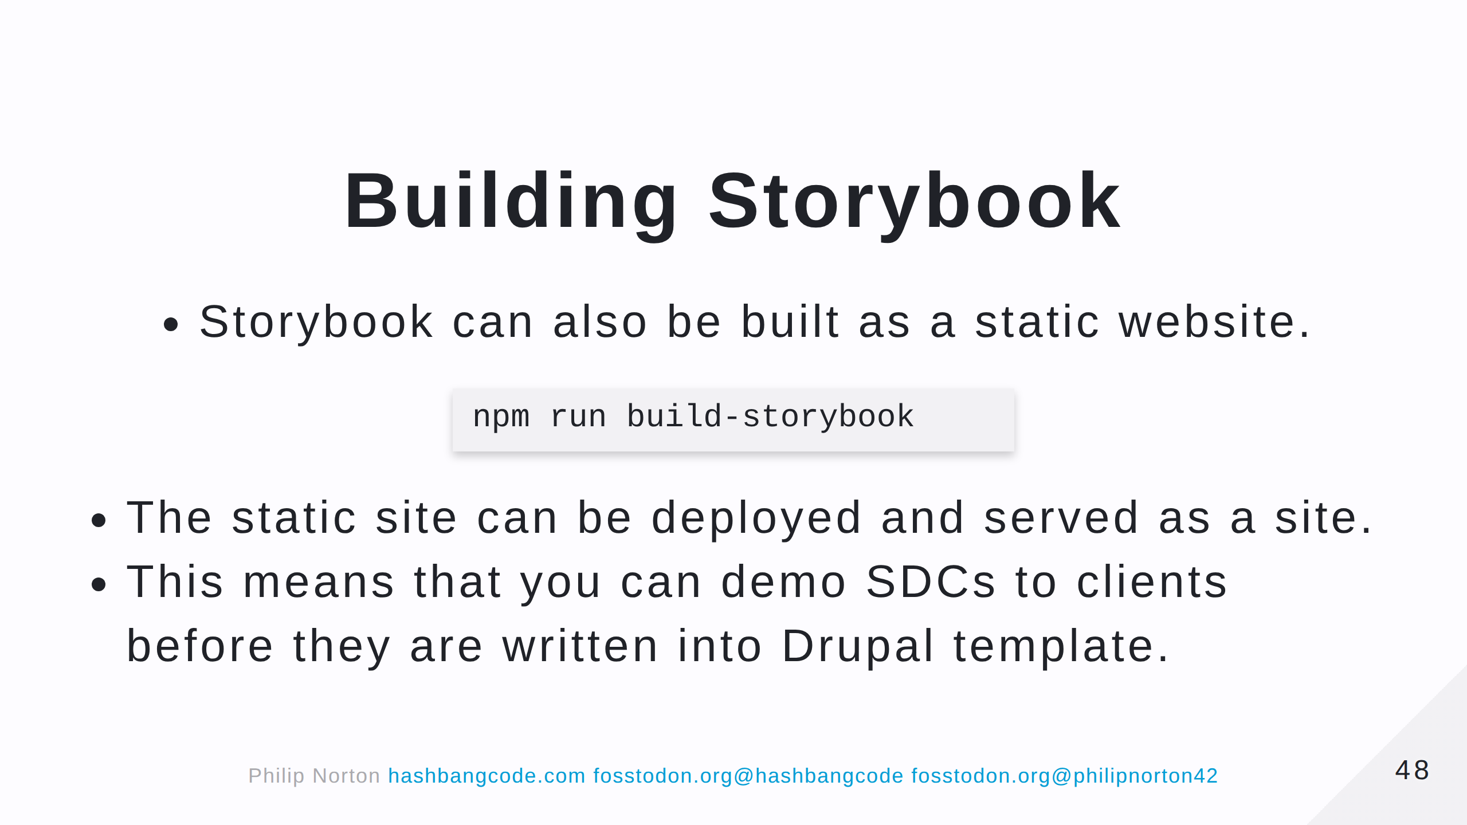

Slide 49
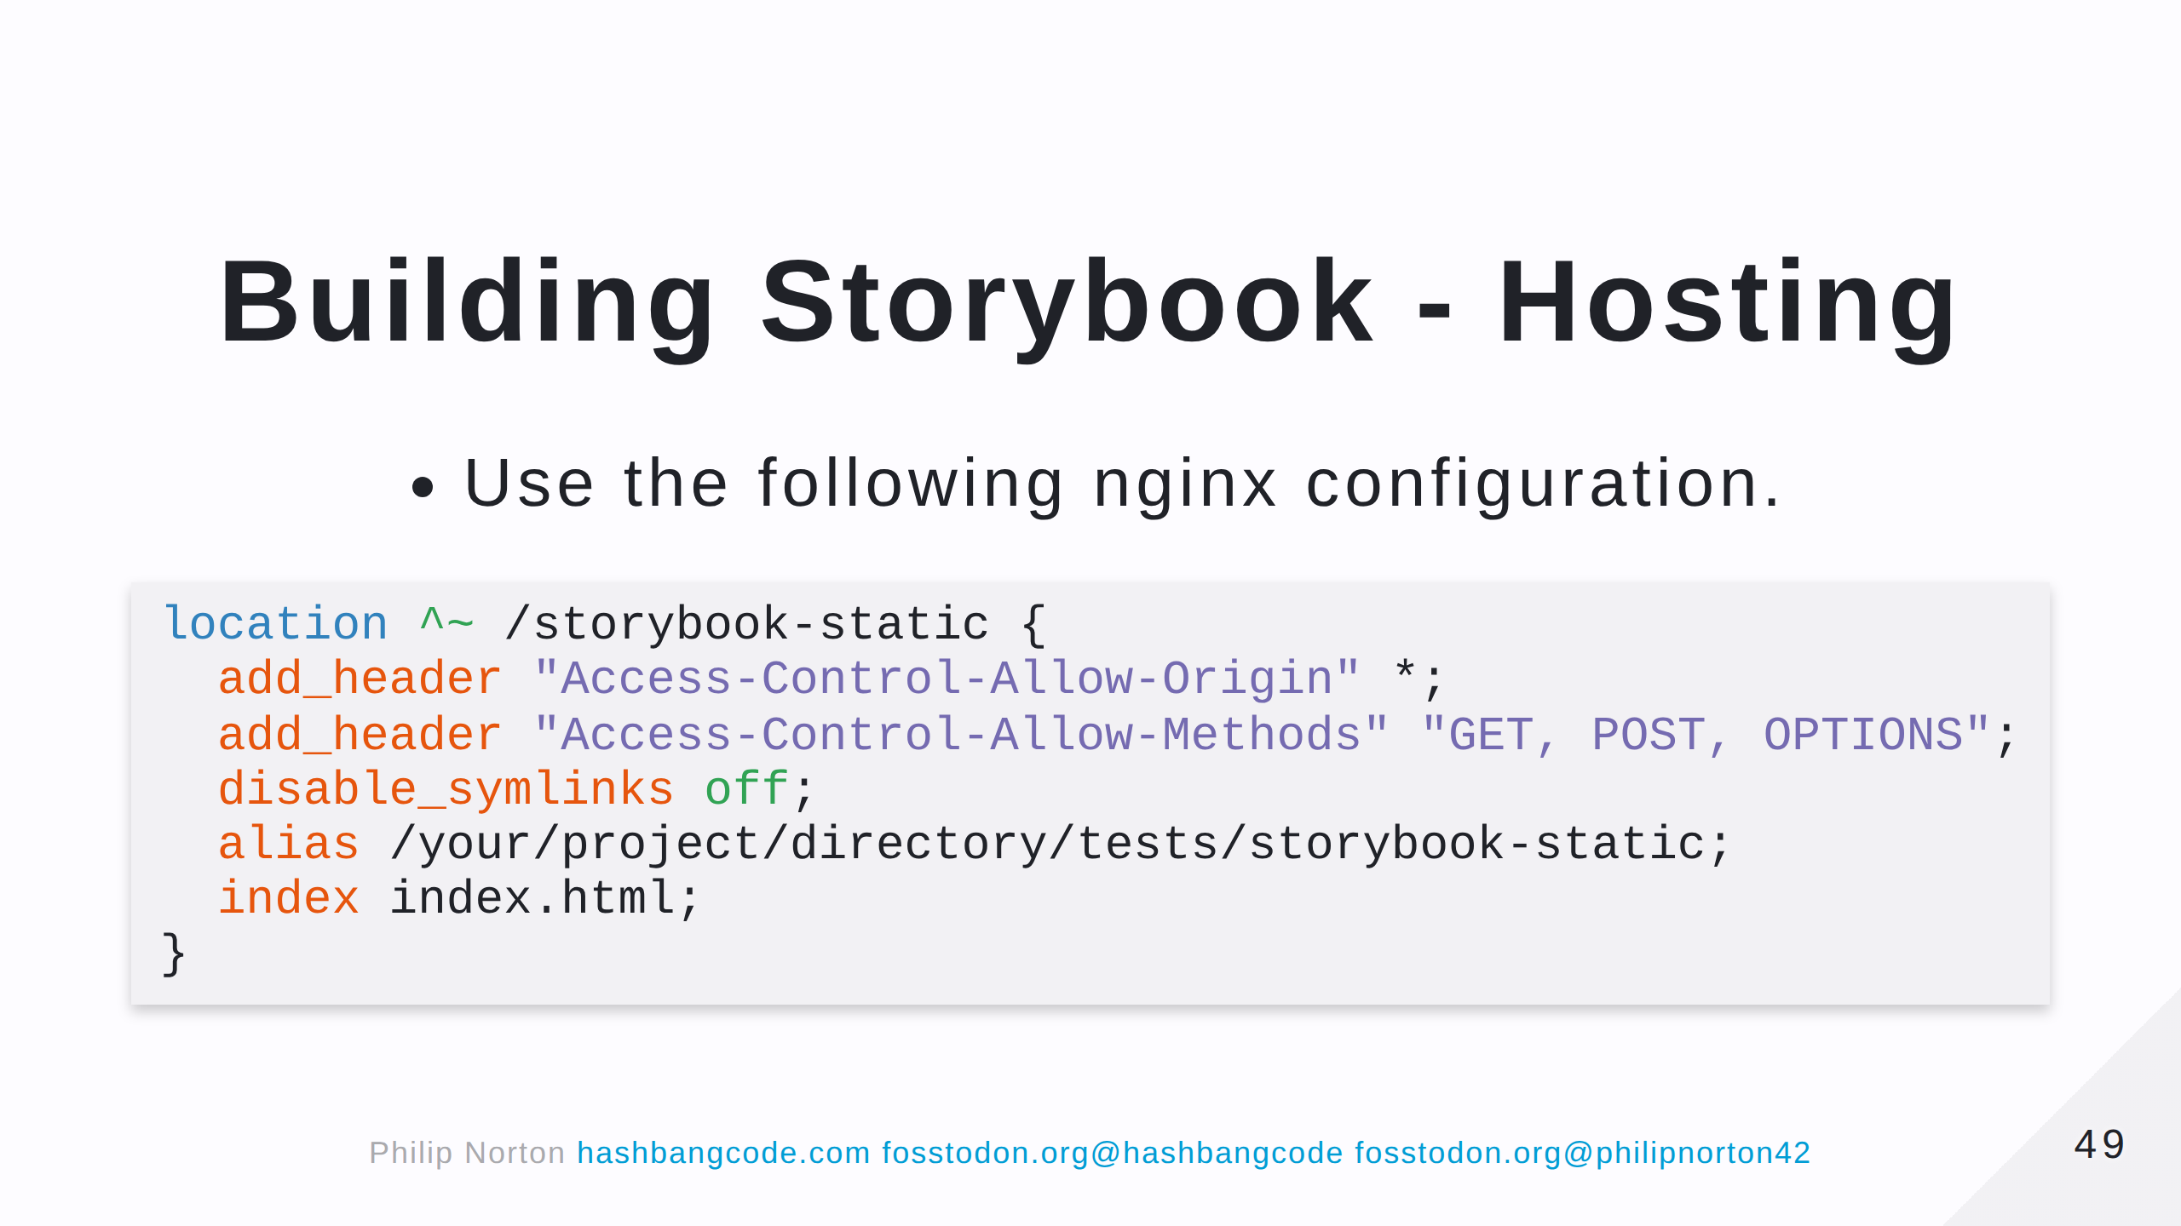

Slide 50
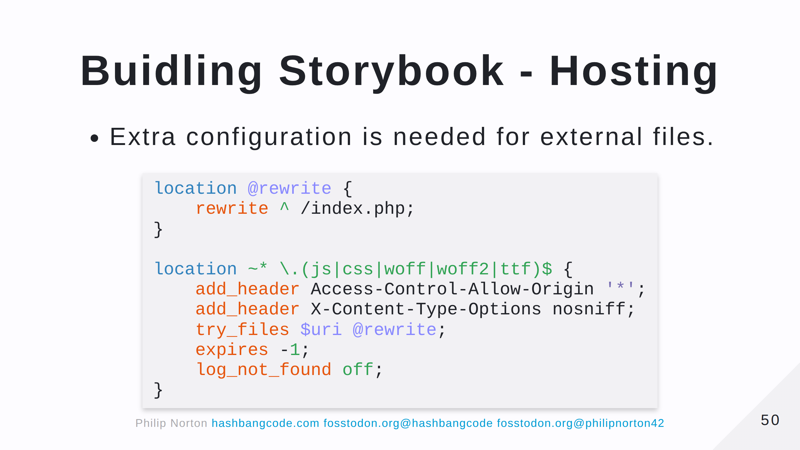

Slide 51
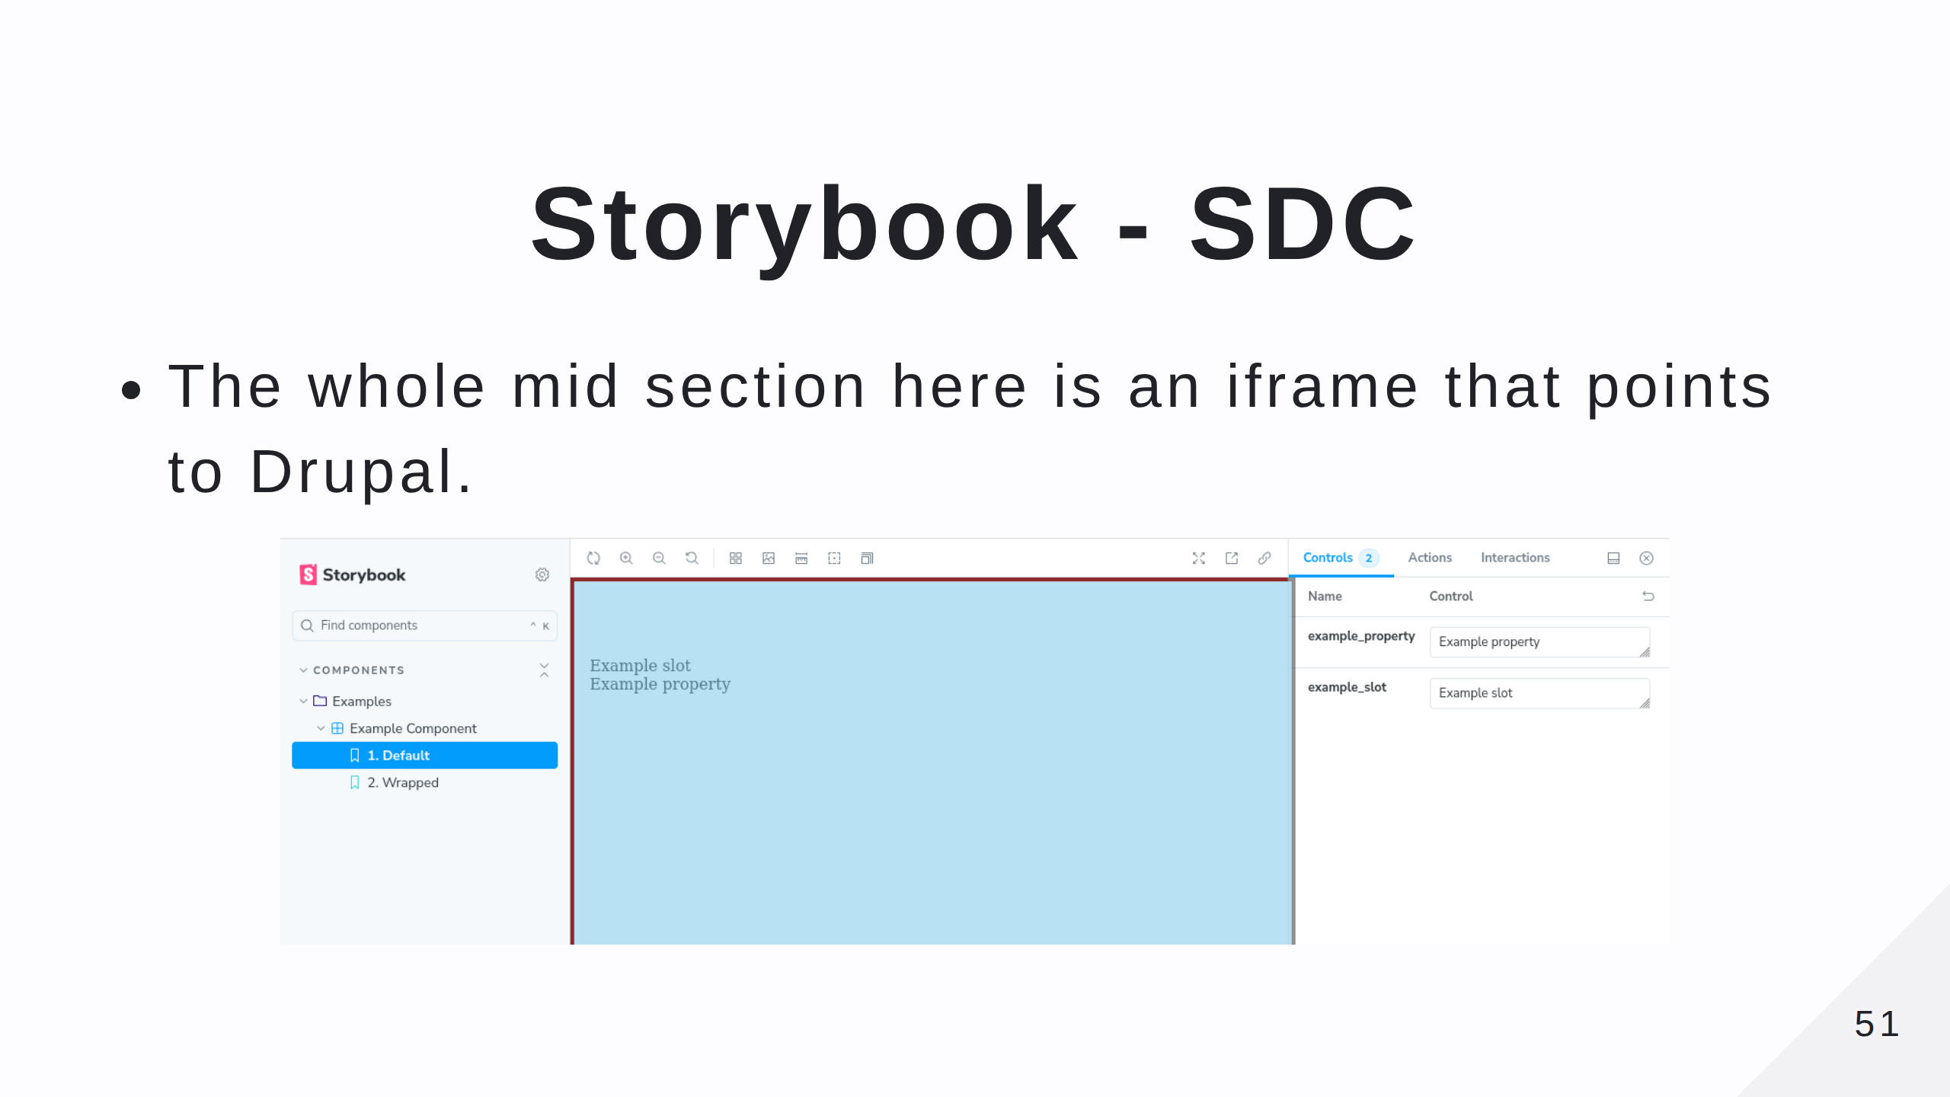

Slide 52


Slide 53


Slide 54

Notes:
CORS errors will likey be your biggest headache. Make notes as you solve them as you can use these notes on other projects.

Slide 55


Slide 56


Slide 57

Notes:
A good alternative if you don't want to muck about with storybook. Plus, comes with an accessibility scanner.

Slide 58

Notes:
A bit unstable in places.

Slide 59

Notes:
Whilst theoretically possible, no SDC is an island.

Slide 60


Slide 61


Slide 62


